Slide 1
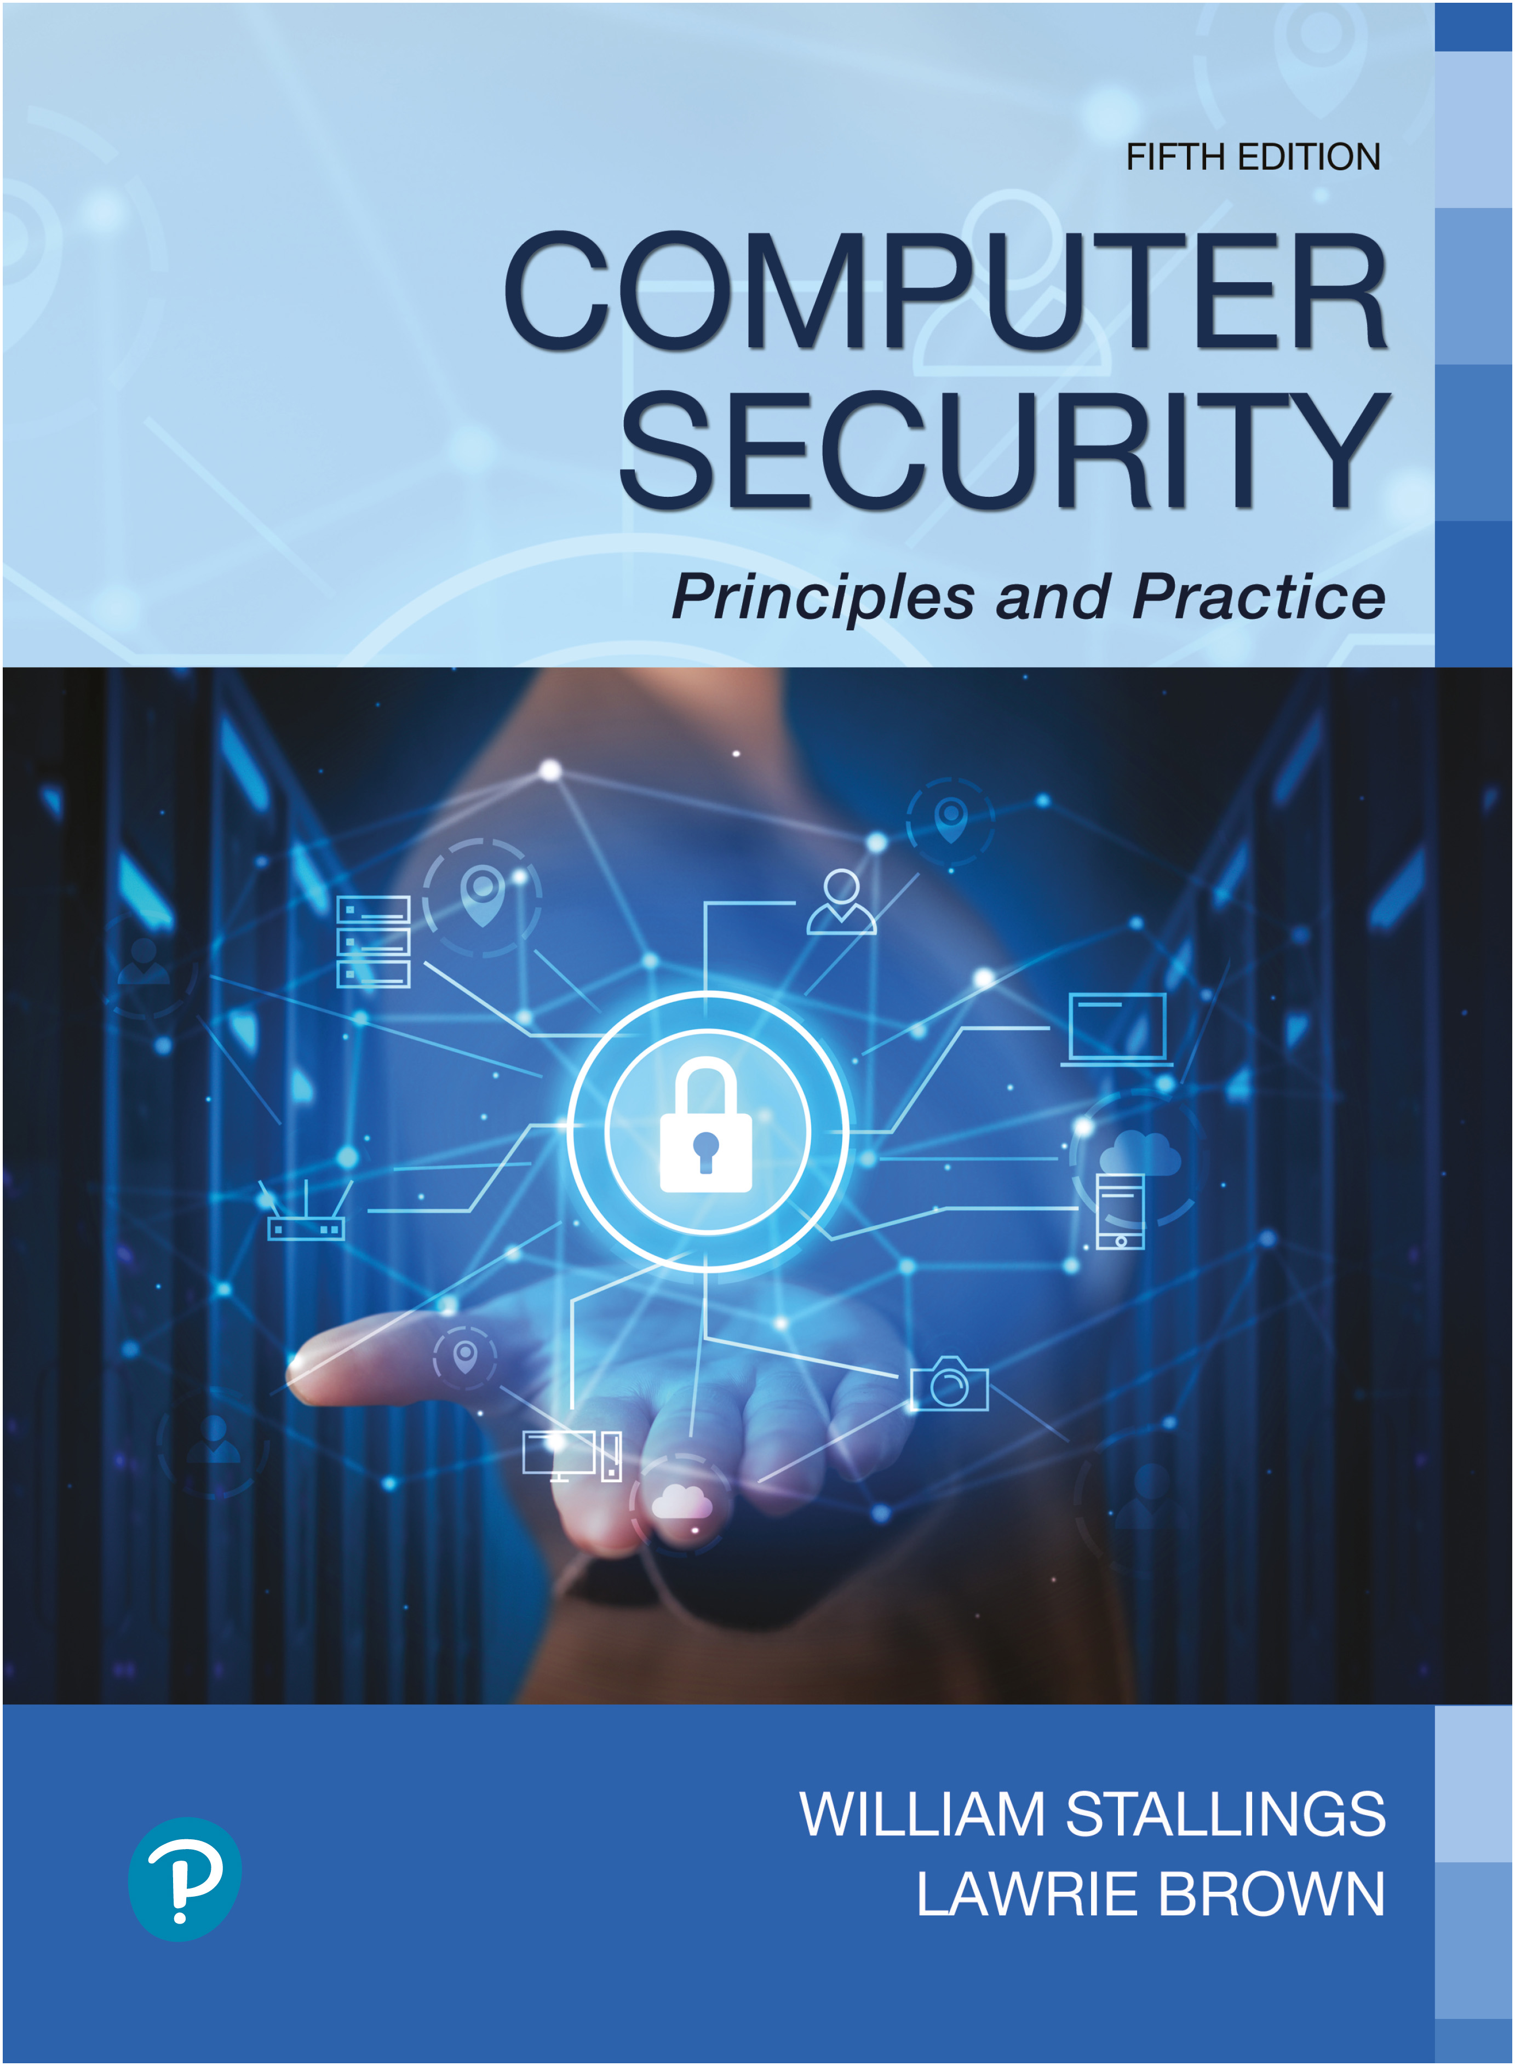

Computer Security: Principles and Practice
Fifth Edition
Chapter 5
Database and Data Center Security
Copyright © 2024, 2018, 2015 Pearson Education, Inc. All Rights Reserved
Notes:
If this PowerPoint presentation contains mathematical equations, you may need to check that your computer has the following installed:
1) MathType Plugin
2) Math Player (free versions available)
3) NVDA Reader (free versions available)
This chapter looks at the unique security issues that relate to databases. The focus of this chapter is on relational database management systems (R D B M S). The relational approach dominates industry, government, and research sectors and is likely to do so for the foreseeable future. We begin with an overview of the need for database-specific security techniques. Then we provide a brief introduction to database management systems, followed by an overview of relational databases. Next, we look at the issue of database access control, followed by a discussion of the inference threat. Then, we examine database encryption. Finally, we examine the security issues related to the deployment of large data centers.

Slide 2
Database Security
Reasons database security has not kept pace with the increased reliance on databases are:
There is a dramatic imbalance between the complexity of modern database management systems (D B M S) and the security technique used to protect these critical systems
Databases have a sophisticated interaction protocol, Structured Query Language (S Q L), which is complex
Effective database security requires a strategy based on a full understanding of the security vulnerabilities of S Q L
The typical organization lacks full-time database security personnel
Most enterprise environments consist of a heterogeneous mixture of database platforms, enterprise platforms, and O S platforms, creating an additional complexity hurdle for security personnel
The increasing reliance on cloud technology to host part or all of the corporate database
Notes:
Organizational databases tend to concentrate sensitive information in a single logical system. Examples include:
• Corporate financial data
• Confidential phone records
• Customer and employee information, such as name, Social Security number, bank account information, credit card information
• Proprietary product information
• Health care information and medical records
For many businesses and other organizations, it is important to be able to provide customers, partners, and employees with access to this information. But such information can be targeted by internal and external threats of misuse or unauthorized change. Accordingly, security specifically tailored to databases is an increasingly important component of an overall organizational security strategy.
[B E N N 06] cites the following reasons why database security has not kept pace with the increased reliance on databases:
1. There is a dramatic imbalance between the complexity of modern database management systems (D B M S) and the security techniques used to protect these critical systems. A D B M S is a very complex, large piece of software that provides many options, all of which need to be well understood and then secured to avoid data breaches. Although security techniques have advanced, the increasing complexity of the D B M S—with many new features and services—has brought a number of new vulnerabilities and the potential for misuse.
2. Databases have a sophisticated interaction protocol called the Structured Query Language (S Q L), which is far more complex than, for example, the Hypertext Transfer Protocol (H T T P) used to interact with a Web service. Effective database security requires a strategy based on a full understanding of the security vulnerabilities of S Q L.
3. The typical organization lacks full-time database security personnel. The result is a mismatch between requirements and capabilities. Most organizations have a staff of database administrators, whose job is to manage the database to ensure availability, performance, correctness, and ease of use. Such administrators may have limited knowledge of security and little available time to master and apply security
techniques. On the other hand, those responsible for security within an organization may have very limited understanding of database and D B M S technology.
4. Most enterprise environments consist of a heterogeneous mixture of database platforms (Oracle, I B M D B2 and Informix, Microsoft, Sybase, etc.), enterprise platforms (Oracle E-Business Suite, PeopleSoft, S A P, Siebel, etc.), and O S platforms (U N I X, Linux, z/O S, and Windows, etc.). This creates an additional complexity hurdle for security personnel.
An additional recent challenge for organizations is their increasing reliance on cloud technology to host part or all of the corporate database. This adds an additional burden to the security staff.

Slide 3
Databases
Structured collection of data stored for use by one or more applications
Contains the relationships between data items and groups of data items
Can sometimes contain sensitive data that needs to be secured
Query language
Provides a uniform interface to the database for users and applications
Database management system (D B M S)
Suite of programs for constructing and maintaining the database
Offers ad hoc query facilities to multiple users and applications
Notes:
In some cases, an organization can function with a relatively simple collection of files of data. Each file may contain text (e.g., copies of memos and reports) or numerical data (e.g., spreadsheets). A more elaborate file consists of a set of records. However, for an organization of any appreciable size, a more complex structure known as a database is required. A database is a structured collection of data stored for use by one or more applications. In addition to data, a database contains the relationships between data items and groups of data items. As an example of the distinction between data files and a database, consider the following. A simple personnel file might consist of a set of records, one for each employee. Each record gives the employee’s name, address, date of birth, position, salary, and other details needed by the personnel department. A personnel database includes a personnel file, as just described. It may also include a time and attendance file, showing for each week the hours worked by each employee. With a database organization, these two files are tied together so that a payroll program can extract the information about time worked and salary for each employee to generate paychecks.
Accompanying the database is a database management system (D B M S), which is a suite of programs for constructing and maintaining the database and for offering ad hoc query facilities to multiple users and applications. A query language provides a uniform interface to the database for users and applications.

Slide 4
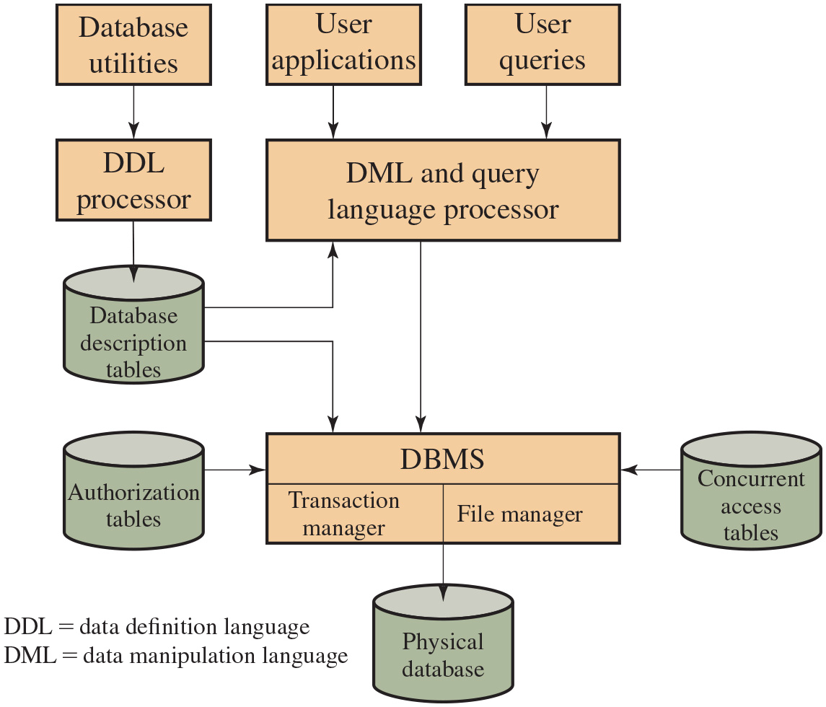
Figure 5.1
D B M S Architecture
Notes:
Figure 5.1 provides a simplified block diagram of a DBMS architecture. Database designers and administrators make use of a data definition language (DDL) to define the database logical structure and procedural properties, which are represented by a set of database description tables. A data manipulation language (DML) provides a powerful set of tools for application developers. Query languages are declarative languages designed to support end users. The database management system makes use of the database description tables to manage the physical database. The interface to the database is through a file manager module and a transaction manager module. In addition to the database description table, two other tables support the DBMS. The DBMS uses authorization tables to ensure the user has permission to execute the query language statement on the database. The concurrent access table prevents conflicts when simultaneous, conflicting commands are executed.
Database systems provide efficient access to large volumes of data and are vital to the operation of many organizations. Because of their complexity and criticality, database systems generate security requirements that are beyond the capability of typical OS-based security mechanisms or stand-alone security packages.
Operating system security mechanisms typically control read and write access to entire files. So they could be used to allow a user to read or to write any information in, for example, a personnel file. But they could not be used to limit access to specific records or fields in that file. A DBMS typically does allow this type of more detailed access control to be specified. It also usually enables access controls to be specified over a wider range of commands, such as to select, insert, update, or delete specified items in the database. Thus, security services and mechanisms that are designed specifically for, and integrated with, database systems are needed.
The sequence of block diagram is as follows. Step 1. Database utilities. Step 2. D D L processor. Step 3. Database description. Step 4. D M L and query language processor. Step 5. D B M S with transaction manager and file manager interface. The D B M S has authorization support table and concurrent access tables. Step 6. D B M S provides physical database. The user application and user queries section provides data to D M L and query language process and then to D B M S with two interfaces. The physical data is obtained from D B M S.
Long Description:
The flow chart consists of the following blocks: Database utilities, User applicants, User queries, D D L processor, D M L, and query language processor, Database description tables, D B M S, Authorization tables, Concurrent access tables, and physical database. Here, D D L equals data definition language and D M L equals data manipulation language. The flow chart can be described as follows. The user applications and the user queries first enter the D M L, and query language processor. At the same time, the database utilities also signal the D D L processor. The D D L processor then signals the database description tables, which in turn signals the D M L and query language processor and the D B M S. The D B M S also receives signals from the authorization tables, the D M L and query language processor, and the concurrent access tables. The D B M S consists of the transaction manager and the file manager, and it signals the physical database.

Slide 5
Relational Databases
Table of data consisting of rows and columns
Each column holds a particular type of data
Each row contains a specific value for each column
Ideally has one column where all values are unique, forming an identifier/key for that row
Enables the creation of multiple tables linked together by a unique identifier that is present in all tables
Use a relational query language to access the database
Allows the user to request data that fit a given set of criteria
Notes:
A relational database is the most widely implemented type of database, along with its associated relational database management system (R D B M S). The basic building block of a relational database is a table of data consisting of rows and columns, similar to a spreadsheet. Each column holds a particular type of data, while each row contains a specific value for each column. Ideally, the table has at least one column in which each value is unique, thus serving as an identifier for a given entry. For example, a typical telephone directory contains one entry for each subscriber, with columns for name, telephone number, and address. Such a table is called a flat file because it is a single two-dimensional (rows and columns) file. In a flat file, all of the data are stored in a single table. For the telephone directory, there might be a number of subscribers with the same name, but the telephone numbers should be unique, so that the telephone number serves as a unique identifier for a row. However, two or more people sharing the same phone number might each be listed in the directory. To continue to hold all of the data for the telephone directory in a single table and to provide for a unique identifier for each row, we could require a separate column for secondary subscriber, tertiary subscriber, and so on. The result would be that for each telephone number in use, there is a single entry in the table.
The drawback of using a single table is that some of the column positions for a given row may be blank (not used). Also, any time a new service or new type of information is incorporated in the database, more columns must be added and the database and accompanying software must be redesigned and rebuilt.
The relational database structure enables the creation of multiple tables tied together by a unique identifier that is present in all tables.
Users and applications use a relational query language to access the database. The query language uses declarative statements rather than the procedural instructions of a programming language. In essence, the query language allows the user to request selected items of data from all records that fit a given set of criteria. The software then figures out how to extract the requested data from one or more tables. For example, a telephone company representative could retrieve a subscriber’s billing information as well as the status of special services or the latest payment received, all displayed on one screen.

Slide 6
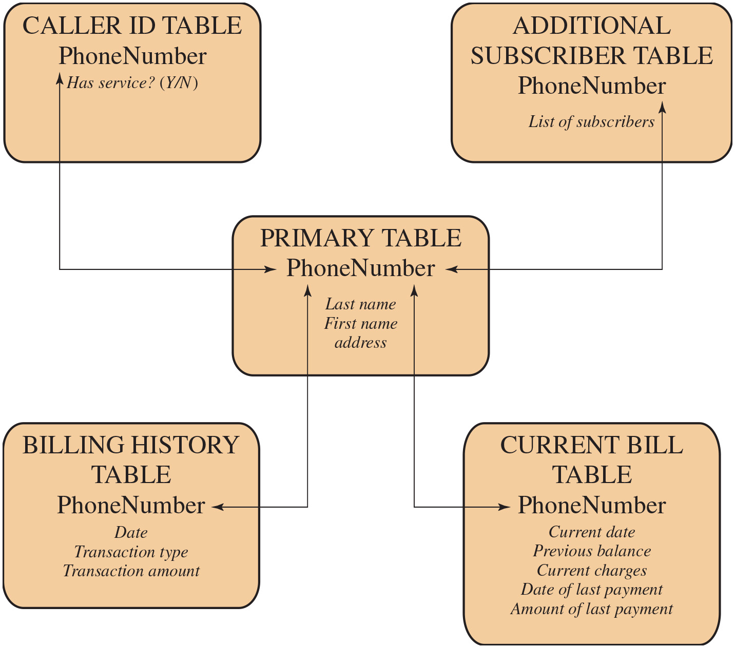
Figure 5.2
Example Relational Database Model
A relational database uses multiple tables related to one another by a designated key; in this case, the key is the PhoneNumber field.
Notes:
Figure 5.2 shows how new services and features can be added to the telephone database without reconstructing the main table. In this example, there is a primary table with basic information for each telephone number. The telephone number serves as a primary key. The database administrator can then define a new table with a column for the primary key and other columns for other information.
Long Description:
The diagram consists of the following five components: Primary table, caller I D table, additional subscriber table, billing history table, and current bill table. The primary table interacts separately with the remaining four tables. Each table requires phone numbers with some other contents. The lists of those required contents within each table are given as follows. Primary table: last name, first name, address. Caller I D table: has service yes or no. Additional subscriber: list of subscribers. Billing history: date, transaction type, transaction amount. Current bill: current date, previous balance, current charges, date of last payment, amount of last payment.

Slide 7
Relational Database Elements
Relation
Table/file
Tuple
Row/record
Attribute
Column/field
Primary key
Uniquely identifies a row
Consists of one or more column names
Foreign key
Links one table to attributes in another
View/virtual table
Result of a query that returns selected rows and columns from one or more tables
Views are often used for security purposes
Notes:
In relational database parlance, the basic building block is a relation, which is a flat table. Rows are referred to as tuples, and columns are referred to as attributes
A primary key is defined to be a portion of a row used to uniquely identify a row in a table; the primary key consists of one or more column names. In the example of Figure 5.2, a single attribute, PhoneNumber, is sufficient to uniquely identify a row in a particular table.
To create a relationship between two tables, the attributes that define the primary key in one table must appear as attributes in another table, where they are referred to as a foreign key. Whereas the value of a primary key must be unique for each tuple (row) of its table, a foreign key value can appear multiple times in a table, so that there is a one-to-many relationship between a row in the table with the primary key and rows in the table with the foreign key.
A view is a virtual table. In essence, a view is the result of a query that returns selected rows and columns from one or more tables.
Views are often used for security purposes. A view can provide restricted access to a relational database so that a user or application only has access to certain rows or columns.

Slide 8
Table 5.1
Basic Terminology for Relational Databases
Formal Name | Common Name | Also Known As
Relation | Table | File
Tuple | Row | Record
Attribute | Column | Field
Notes:
Basic Terminology for Relational Databases

Slide 9
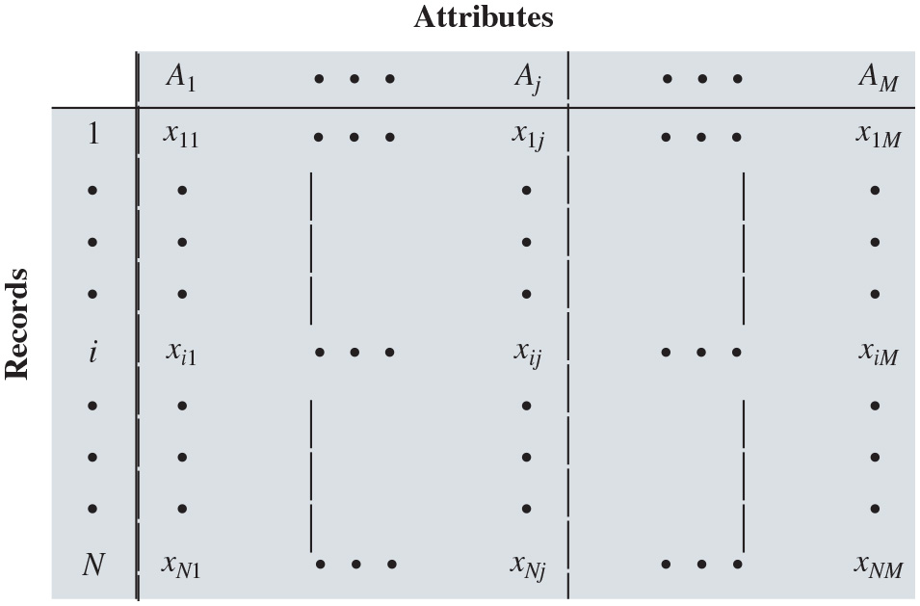
Figure 5.3
Abstract Model of a Relational Database
Notes:
An abstract model of a relational database table is shown in Figure 5.3. There are N individuals, or entities, in the table and M attributes. Each attribute Aj has |Aj | possible values, with xij denoting the value of attribute j for entity i.
The table is as follows. There are N individuals, or entities, in the table and M attributes. Each attribute A sub j has A sub j possible values, with x sub start expression i j end expression denoting the value of attribute j for entity i. The columns are labeled attributes and the rows are labeled, records. Row 1. blank, A sub 1, ellipsis, A sub j, ellipsis, A sub M. Row 2. 1, x sub 11, ellipsis, x sub start expression 1 j end expression, ellipsis, x sub start expression 1 M end expression. Row 3. Ellipsis, ellipsis, ellipsis. Row 4. i, x sub start expression i 1 end expression, ellipsis, x sub start expression i j end expression, ellipsis, x sub start expression i M end expression. Row 5. Ellipsis, ellipsis, ellipsis. Row 6. N, x sub start expression N 1, ellipsis, x sub start expression N j end expression, ellipsis, x sub start expression N M end expression.
Long Description:
The array takes the number of records varying from i equals 1 to N and takes attributes, denoted by A subscript j from A subscript 1 to A subscript M. The lists of arrays corresponding to M attributes and N records form a matrix of N by M order. The elements in each array are denoted by the variable x subscript i j corresponding to each value of i and j in the given range.

Slide 10
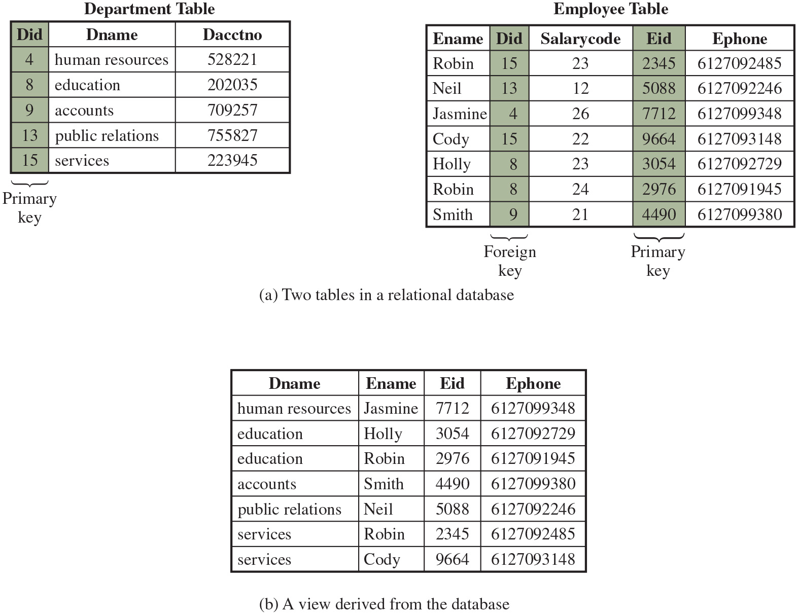
Figure 5.4
Relational Database Example
Notes:
Figure 5.4a provides a relational database example. In the Department table, the department I D (D i d) is the primary key; each value is unique. This table gives the I D, name, and account number for each department. The Employee table contains the name, salary code, employee I D, and phone number of each employee. The Employee table also indicates the department to which each employee is assigned by including D i d. D i d is identified as a foreign key and provides the relationship between the Employee table and the Department table.
Figure 5.4b is a view that includes the employee name, I D, and phone number from the Employee table and the corresponding department name from the Department table. The linkage is the D i d, so that the view table includes data from each row of the Employee table, with additional data from the Department table. It is also possible to construct a view from a single table. For example, one view of the Employee table consists of all rows, with the salary code column deleted. A view can be qualified to include only some rows and/or some columns. For example, a view can be defined consisting of all rows in the Employee table for which the D i d = 15.
Long Description:
Part (a): Two tables in a relational database are shown. One of the tables represents the data regarding the departments and the other represents the data regarding the employees. The department table consists of 5 rows and 3 columns, with the D i d, the column being the primary key. The columns have the following headings from left to right: D i d, D name, D acct no. The row entries in the table are given as follows. Row 1: 4, human resources, 528221. Row 2: 8, education, 202035. Row 3: 9, accounts, 709257. Row 4: 13, public relations, 755827. Row 5: 15, services, 223945. The employee table consists of 7 rows and 5 columns, with the D i d, and E i d, columns being the Foreign key and primary keys. The columns have the following headings from left to right: E name, D i d, salary code, E i d, E phone. The row entries in the table are given as follows. Row 1: Robin, 15, 23, 2345, 6127092485. Row 2: Neil, 13, 12, 5088, 6127092246. Row 3: Jasmine, 4, 26, 7712, 6127099348. Row 4: Cody, 15, 22, 9664, 6127093148. Row 5. Holly, 8, 23, 3054, 6127092729. Row 6. Robin, 8, 24, 2976, 6127091945. Row 7. Smith, 9, 21, 4490, 6127099380.
Part (b): A view derived from the database is shown in a table. The table consists of 7 rows and 4 columns. The columns have the following headings from left to right: D name, E name, E i d, E phone. The row entries in table are given as follows. Row 1: human resources, Jasmine, 7712, 6127099348. Row 2: education, Holly, 3054, 6127092729. Row 3: education, Robin, 2976, 6127091945. Row 4: accounts, Smith, 4490, 6127099380. Row 5: public relations, Neil, 5088, 6127092246. Row 6: services, Robin, 2345, 6127092485. Row 7: services, Cody, 9664, 6127093148.

Slide 11
Structured Query Language (S Q L)
Standardized language to define schema, manipulate, and query data in a relational database
Several similar versions of A N S I/I S O standard
All follow the same basic syntax and semantics
S Q L statements can be used to:
Create tables
Insert and delete data in tables
Create views
Retrieve data with query statements
Notes:
Structured Query Language (S Q L) is a standardized language that can be used to define schema, manipulate data, and query data in a relational database. There are several versions of the A N S I/I S O standard and a variety of different implementations, but all follow the same basic syntax and semantics.
S Q L statements can be used to create tables, insert and delete data in tables, create views, and retrieve data with query statements.

Slide 12
S Q L Injection Attacks (S Q L i)
One of the most prevalent and dangerous network-based security threats
Designed to exploit the nature of Web application pages
Sends malicious S Q L commands to the database server
Most common attack goal is bulk extraction of data
Depending on the environment S Q L injection can also be exploited to:
Modify or delete data
Execute arbitrary operating system commands
Launch denial-of-service (D o S) attacks
Notes:
The S Q L injection (S Q L i) attack is one of the most prevalent and dangerous network-based security threats. Consider the following reports:
1. The July 2013 Imperva Web Application Attack Report [I M P E 13] surveyed a cross-section of Web application servers in industry and monitored eight different types of common attacks. The report found that S Q L i attacks ranked first or second in total number of attack incidents, the number of attack requests per attack incident, and average number of days per month that an application experienced at least one attack incident. Imperva observed a single website that received 94,057 S Q L injection attack requests in one day.
2. The Open Web Application Security Project’s 2021 report [O W A S 21] on the 10 most critical Web application security risks listed injection attacks, including
S Q L i attacks, as the third highest risk, down from top place in the previous reports.
3. The Veracode 2016 State of Software Security Report [V E R A 16] found that percentage of applications affected by S Q L i attacks is around 35%.
4. The Trustwave 2016 Global Security Report [T R U S 16] lists S Q L i attacks as one of the top two intrusion techniques. The report notes that S Q L i can pose a significant threat to sensitive data such as personally identifiable information (PII) and credit card data, and it can be hard to prevent and relatively easy to exploit these attacks.
In general terms, an S Q L i attack is designed to exploit the nature of Web application pages. In contrast to the static webpages of years gone by, most current websites have dynamic components and content. Many such pages ask for information, such as location, personal identity information, and credit card information. This dynamic content is usually transferred to and from back-end databases that contain volumes of information—anything from cardholder data to which type of running shoes is most purchased. An application server webpage will make S Q L queries to databases to send and receive information critical to creating a positive user experience.
In such an environment, an S Q L i attack is designed to send malicious S Q L commands to the database server. The most common attack goal is bulk extraction of data. Attackers can dump database tables with hundreds of thousands of customer records. Depending on the environment, S Q L injection can also be exploited to modify or delete data, execute arbitrary operating system commands, or launch denial-of-service (D o S) attacks.

Slide 13
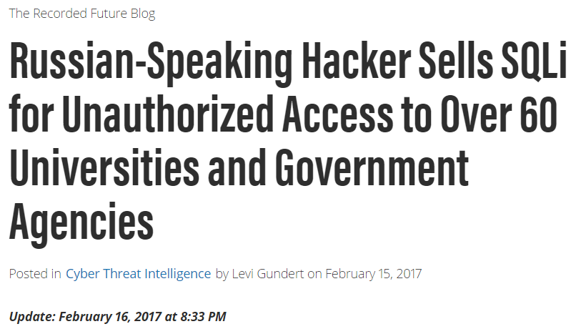
SQL Injection Attacks (SQLi)
SJW
Notes:
The SQL injection (SQLi) attack is one of the most prevalent and dangerous
network-based security threats. Consider the following reports:
1. The July 2013 Imperva Web Application Attack Report [IMPE13] surveyed a
cross-section of Web application servers in industry and monitored eight different
types of common attacks. The report found that SQLi attacks ranked
first or second in total number of attack incidents, the number of attack
requests per attack incident, and average number of days per month that an
application experienced at least one attack incident. Imperva observed a single
Web site that received 94,057 SQL injection attack requests in one day.
2. The Open Web Application Security Project’s 2013 report [OWAS13] on the
ten most critical Web application security risks listed injection attacks, especially
SQLi attacks, as the top risk. This ranking is unchanged from its 2010 report.
3. The Veracode 2013 State of Software Security Report [VERA13] found that
percentage of applications affected by SQLi attacks is around 32% and that
SQLi attacks account for 26% of all reported breaches. Veracode also considers
this among the most dangerous threats, reporting that three of the biggest
SQL injection attacks in 2012 resulted in millions of email addresses, user
names, and passwords being exposed and damaged the respective brands.
4. The Trustwave 2013 Global Security Report [TRUS13] lists SQLi attacks as
one of the top two intrusion techniques. The report notes that poor coding
practices have allowed the SQL injection attack vector to remain on the threat
landscape for more than 15 years, but that proper programming and security
measures can prevent these attacks.
In general terms, an SQLi attack is designed to exploit the nature of Web application
pages. In contrast to the static Web pages of years gone by, most current Web sites
have dynamic components and content. Many such pages ask for information, such
as location, personal identity information, and credit card information. This dynamic
content is usually transferred to and from back-end databases that contain volumes of
information—anything from cardholder data to which type of running shoes is most
purchased. An application server Web page will make SQL queries to databases to
send and receive information critical to making a positive user experience.
In such an environment, an SQLi attack is designed to send malicious SQL
commands to the database server. The most common attack goal is bulk extraction
of data. Attackers can dump database tables with hundreds of thousands of customer
records. Depending on the environment, SQL injection can also be exploited
to modify or delete data, execute arbitrary operating system commands, or launch
denial-of-service (DoS) attacks.

Slide 14
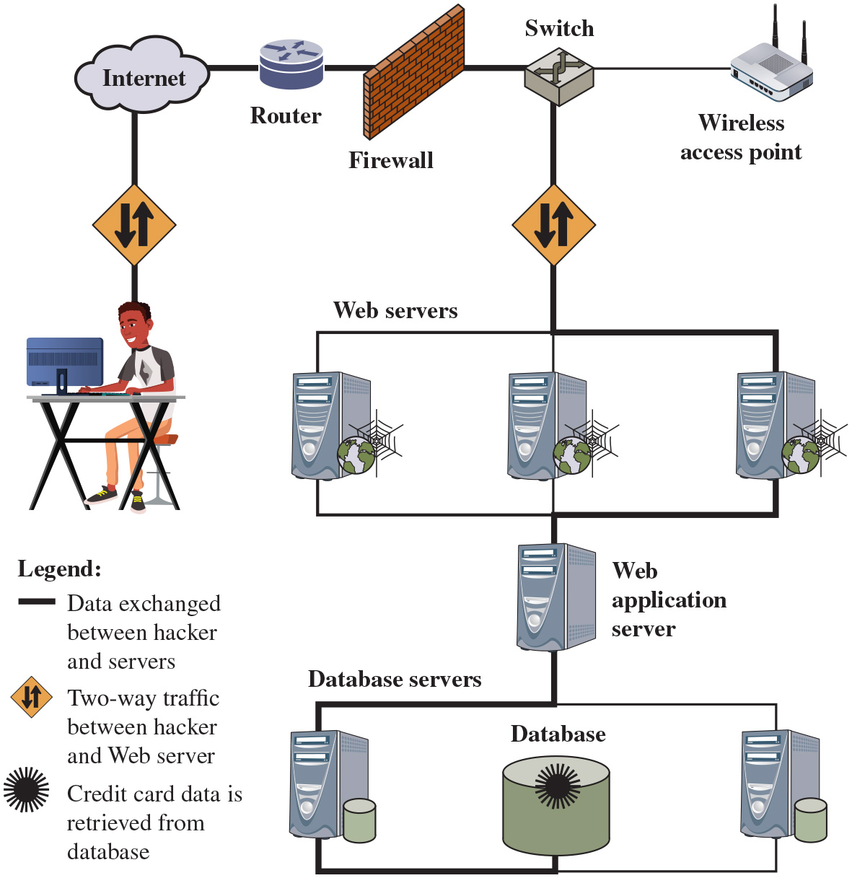
Figure 5.5
Typical S Q L Injection Attack
Anonymous and others use a tool known as Havij to automate SQL injection attacks
Havij 101
SJW
Notes:
SQLi is an attack that exploits a security vulnerability occurring in the database layer of an application (such as queries). Using SQL injection, the attacker can extract or manipulate the web application’s data. The attack is viable when user input is either incorrectly filtered for string literal escape characters embedded in SQL statements or not strongly typed and thereby unexpectedly executed.
Figure 5.5, from [ACUN13], is a typical example of an SQLi attack. The steps involved are as follows:
1. Hacker finds a vulnerability in a custom Web application and injects an SQL command to a database by sending the command to the Web server. The command is injected into traffic that will be accepted by the firewall.
2. The Web server receives the malicious code and sends it to the Web application server.
3. The Web application server receives the malicious code from the Web server and sends it to the database server.
4. The database server executes the malicious code on the database. The database returns data from the credit cards table.
5. The Web application server dynamically generates a page with data, including credit card details from the database.
6. The Web server sends the credit card details to the hacker.
Long Description: The pictorial diagram consists of the following components: a hacker, internet, router, firewall, switch, wireless access point, web servers, web application server, database servers, and database. There are three legends used in the flow chart taking their meanings as follows. 1. The connecting lines show data is exchanged between the hacker and servers. 2. Backward and forward arrows show two-way traffic between hacker and web server. 3. A patch symbol shows credit card data is retrieved from the database. The flow chart can be explained as follows. The hacker first accesses the router via the internet through a two-way traffic, gaining accessing to the system beyond the firewall connected with a switch with a wireless access point. The hacker then accesses the web application server via web servers through a two-way traffic. From the web application server, the hacker progresses into the database servers, which can be used to retrieve credit card data from the database.

Slide 15
Injection Technique
The S Q L i attack typically works by prematurely terminating a text string and appending a new command
Because the inserted command may have additional strings appended to it before it is executed the attacker terminates the injected string with a comment mark “- -”
Subsequent text is ignored at execution time
Notes:
The S Q L i attack typically works by prematurely terminating a text string and appending a new command. Because the inserted command may have additional strings appended to it before it is executed, the attacker terminates the injected string with a comment mark “--”. Subsequent text is ignored at execution time.

Slide 16

SQL Injection Attack
SJW
SJW

Slide 17
S Q L i Attack Avenues (1 of 2)
User input
Attackers inject S Q L commands by providing suitable crafted user input
Server variables
Attackers can forge the values that are placed in H T T P and network headers and exploit this vulnerability by placing data directly into the headers
Second-order injection
A malicious user could rely on data already present in the system or database to trigger an S Q L injection attack, so when the attack occurs, the input that modifies the query to cause an attack does not come from the user, but from within the system itself
Notes:
We can characterize S Q L i attacks in terms of the avenue of attack and the type of attack [C H A N 11, H A L F 06]. The main avenues of attack are as follows:
• User input: In this case, attackers inject S Q L commands by providing suitably crafted user input. A Web application can read user input in several ways based on the environment in which the application is deployed. In most S Q L i attacks that target Web applications, user input typically comes from form submissions that are sent to the Web application via H T T P GET or P O S T requests. Web applications are generally able to access the user input contained in these requests as they would access any other variable in the environment.
• Server variables: Server variables are a collection of variables that contain H T T P headers, network protocol headers, and environmental variables. Web applications use these server variables in a variety of ways, such as logging usage statistics and identifying browsing trends. If these variables are logged to a database without sanitization, this could create an S Q L injection vulnerability. Because attackers can forge the values that are placed in H T T P and network headers, they can exploit this vulnerability by placing data directly into the headers. When the query to log the server variable is issued to the
database, the attack in the forged header is then triggered.
• Second-order injection: Second-order injection occurs when incomplete prevention mechanisms against S Q L injection attacks are in place. In second-order injection, a malicious user could rely on data already present in the system or database to trigger an S Q L injection attack, so when the attack occurs, the input that modifies the query to cause an attack does not come from the user but from within the system itself.
• Cookies: When a client returns to a Web application, cookies can be used to restore the client’s state information. Because the client has control over cookies, an attacker could alter cookies such that when the application server builds an S Q L query based on the cookie’s content, the structure and function of the query is modified.
• Physical user input: S Q L injection is possible by supplying user input that constructs an attack outside the realm of web requests. This user input could take the form of conventional barcodes, R F I D tags, or even paper forms that are scanned using optical character recognition and passed to a database management system.

Slide 18
S Q L i Attack Avenues (2 of 2)
Cookies
An attacker could alter cookies such that when the application server builds an S Q L query based on the cookie’s content, the structure and function of the query is modified
Physical user input
Applying user input that constructs an attack outside the realm of web requests

Slide 19
Inband Attacks
Uses the same communication channel for injecting S Q L code and retrieving results
The retrieved data are presented directly in application webpage
Include:
Tautology
This form of attack injects code in one or more conditional statements so that they always evaluate to true
End-of-line comment
After injecting code into a particular field, legitimate code that follows is nullified through the use of end of line comments
Piggybacked queries
The attacker adds additional queries beyond the intended query, piggybacking the attack on top of a legitimate request
SELECT EmpInfo FROM EmpTable WHERE EmpID = ‘1’ OR ‘1’ = ‘1’
EmpID used doesn’t matter – it evaluates to TRUE for every record in table
SJW
Notes:
Attack types can be grouped into three main categories: inband, inferential, and out-of-band. An inband attack uses the same communication channel for injecting S Q L code and retrieving results. The retrieved data are presented directly in the application webpage. Inband attack types include the following:
• Tautology: This form of attack injects code in one or more conditional statements so that they always evaluate to true.
• End-of-line comment: After injecting code into a particular field, legitimate code that follows is nullified through the use of end of line comments. An example would be to add “--” after inputs so that remaining queries are not treated as executable code, but comments. The preceding tautology example is also of this form.
• Piggybacked queries: The attacker adds additional queries beyond the intended query, piggybacking the attack on top of a legitimate request. This technique relies on server configurations that allow several different queries within a single string of code. The example in the preceding section is of this form.

Slide 20
Inferential Attack
There is no actual transfer of data, but the attacker is able to reconstruct the information by sending particular requests and observing the resulting behavior of the Website/database server
Include:
Illegal/logically incorrect queries
This attack lets an attacker gather important information about the type and structure of the backend database of a Web application
The attack is considered a preliminary, information-gathering step for other attacks
Blind S Q L injection
Allows attackers to infer the data present in a database system even when the system is sufficiently secure to not display any erroneous information back to the attacker
Notes:
With an inferential attack, there is no actual transfer of data, but the attacker is able to reconstruct the information by sending particular requests and observing the resulting behavior of the Website/database server. Inferential attack types include the following:
• Illegal/logically incorrect queries: This attack lets an attacker gather important information about the type and structure of the backend database of a Web application. The attack is considered a preliminary, information-gathering step for other attacks. The vulnerability leveraged by this attack is that the default error page returned by application servers is often overly descriptive. In fact, the simple fact that an error message is generated can often reveal vulnerable/injectable parameters to an attacker.
• Blind S Q L injection: Blind S Q L injection allows attackers to infer the data present in a database system even when the system is sufficiently secure to not display any erroneous information back to the attacker. The attacker asks the server true/false questions. If the injected statement evaluates to true, the site continues to function normally. If the statement evaluates to false, although there is no descriptive error message, the page differs significantly from the normally functioning page.

Slide 21
Out-of-Band Attack
Data are retrieved using a different channel
This can be used when there are limitations on information retrieval but outbound connectivity from the database server is lax
Notes:
In an out-of-band attack, data are retrieved using a different channel (e.g., an email with the results of the query is generated and sent to the tester). This can be used when there are limitations on information retrieval but outbound connectivity from the database server is lax.

Slide 22
S Q L i Countermeasures
Three types:
Defensive coding
Manual defensive coding practices
Parameterized query insertion
S Q L D O M
Detection
Signature based
Anomaly based
Code analysis
Run-time prevention
Check queries at runtime to see if they conform to a model of expected queries
Regex ^[0-9]$ or ^[0-9A-Za-z]*$ allows numeric string and alpha string, respectively.
Use screen controls such as a pulldown menu for all input; users can only select from valid choices and cannot enter dangerous strings.
SJW
Notes:
Because S Q L i attacks are so prevalent, damaging, and varied both by attack avenue and type, a single countermeasure is insufficient. Rather an integrated set of techniques is necessary. In this section, we provide a brief overview of the types of countermeasures that are in use or being researched, using the classification in [S H A R 13]. These countermeasures can be classified into three types: defensive coding, detection, and run-time prevention.
Many S Q L i attacks succeed because developers have used insecure coding practices. Thus, defensive coding is an effective way to dramatically reduce the threat from S Q L i. Examples of defensive coding include the following:
• Manual defensive coding practices: A common vulnerability exploited by S Q L i attacks is insufficient input validation. The straightforward solution for eliminating these vulnerabilities is to apply suitable defensive coding practices. An example is input type checking, to check that inputs that are supposed to be numeric contain no characters other than digits. This type of technique can avoid attacks based on forcing errors in the database management system. Another type of coding practice is one that performs pattern matching to try to distinguish normal input from abnormal input.
• Parameterized query insertion: This approach attempts to prevent S Q L i by allowing the application developer to more accurately specify the structure of an S Q L query and pass the value parameters to it separately such that any unsanitary user input is not allowed to modify the query structure.
• SQL DOM: S Q L D O M is a set of classes that enables automated data type validation and escaping [M C C L 05]. This approach uses encapsulation of database queries to provide a safe and reliable way to access databases. This changes the query-building process from an unregulated one that uses string concatenation to a systematic one that uses a type-checked A P I. Within the A P I, developers are able to systematically apply coding best practices such as input filtering and rigorous type checking of user input.
A variety of detection methods have been developed, including the following:
• Signature based: This technique attempts to match specific attack patterns. Such an approach must be constantly updated and may not work against self-modifying attacks.
• Anomaly based: This approach attempts to define normal behavior and then detect behavior patterns outside the normal range. A number of approaches have been used. In general terms, there is a training phase, in which the system learns the range of normal behavior, followed by the actual detection phase.
• Code analysis: Code analysis techniques involve the use of a test suite to detect S Q L i vulnerabilities. The test suite is designed to generate a wide range of S Q L i attacks and assess the response of the system.
Finally, a number of run-time prevention techniques have been developed as S Q L i countermeasures. These techniques check queries at runtime to see if they conform to a model of expected queries. Various automated tools are available for this purpose [C H A N 11, S H A R 13].

Slide 23
Database Access Control
Database access control system determines:
If the user has access to the entire database or just portions of it
What access rights the user has (create, insert, delete, update, read, write)
Can support a range of administrative policies
Centralized administration
Small number of privileged users may grant and revoke access rights
Ownership-based administration
The creator of a table may grant and revoke access rights to the table
Decentralized administration
The owner of the table may grant and revoke authorization rights to other users, allowing them to grant and revoke access rights to the table
Notes:
Commercial and open-source D B M S s typically provide an access control capability for the database. The D B M S operates on the assumption that the computer system has authenticated each user. As an additional line of defense, the computer system may use the overall access control system described in Chapter 4 to determine whether a user may have access to the database as a whole. For users who are authenticated and granted access to the database, a database access control system provides a specific capability that controls access to portions of the database.
Commercial and open-source D B M S s provide discretionary or role-based access control. Some specialized DBMSs also provide mandatory access control. Typically, a D B M S can support a range of administrative policies, including the following:
• Centralized administration: A small number of privileged users may grant and revoke access rights.
• Ownership-based administration: The owner (creator) of a table may grant and revoke access rights to the table.
• Decentralized administration: In addition to granting and revoking access rights to a table, the owner of the table may grant and revoke authorization rights to other users, allowing them to grant and revoke access rights to the table.
As with any access control system, a database access control system distinguishes different access rights, including create, insert, delete, update, read, and write. Some D B M S s provide considerable control over the granularity of access rights. Access rights can be to the entire database, to individual tables, or to selected rows or columns within a table. Access rights can be determined based on the contents of a table entry. For example, in a personnel database, some users may be limited to seeing salary information only up to a certain maximum value. And a department manager may only be allowed to view salary information for employees in their department.

Slide 24
S Q L Access Controls
Two commands for managing access rights:
Grant
Used to grant one or more access rights or can be used to assign a user to a role
Revoke
Revokes the access rights
Typical access rights are:
Select
Insert
Update
Delete
References
Notes:
S Q L provides two commands for managing access rights, GRANT and REVOKE. For different versions of S Q L, the syntax is slightly different. In general terms, the GRANT command has the following syntax:
GRANT { privileges | role }
[ON table]
TO { user | role | PUBLIC }
[IDENTIFIED BY password]
[WITH GRANT OPTION]
This command can be used to grant one or more access rights or can be used to assign a user to a role. For access rights, the command can optionally specify that it applies only to a specified table. The TO clause specifies the user or role to which the rights are granted. A PUBLIC value indicates that any user has the specified access rights. The optional IDENTIFIED BY clause specifies a password that must be used to revoke the access rights of this GRANT command. The GRANT OPTION indicates that the grantee can grant this access right to other users, with or without the grant option.
As a simple example, consider the following statement.
GRANT SELECT ON ANY TABLE TO ricflair
This statement enables user ricflair to query any table in the database.
Different implementations of SQL provide different ranges of access rights.
The following is a typical list:
• Select: Grantee may read entire database, individual tables, or specific columns in a table.
• Insert: Grantee may insert rows in a table; or insert rows with values for specific columns in a table.
• Update: Semantics is similar to INSERT.
• Delete: Grantee may delete rows from a table.
• References: Grantee is allowed to define foreign keys in another table that refer to the specified columns.
The REVOKE command has the following syntax:
REVOKE { privileges | role }
[ON table]
FROM { user | role | PUBLIC }
Thus, the following statement revokes the access rights of the preceding example:
REVOKE SELECT ON ANY TABLE FROM ricflair

Slide 25
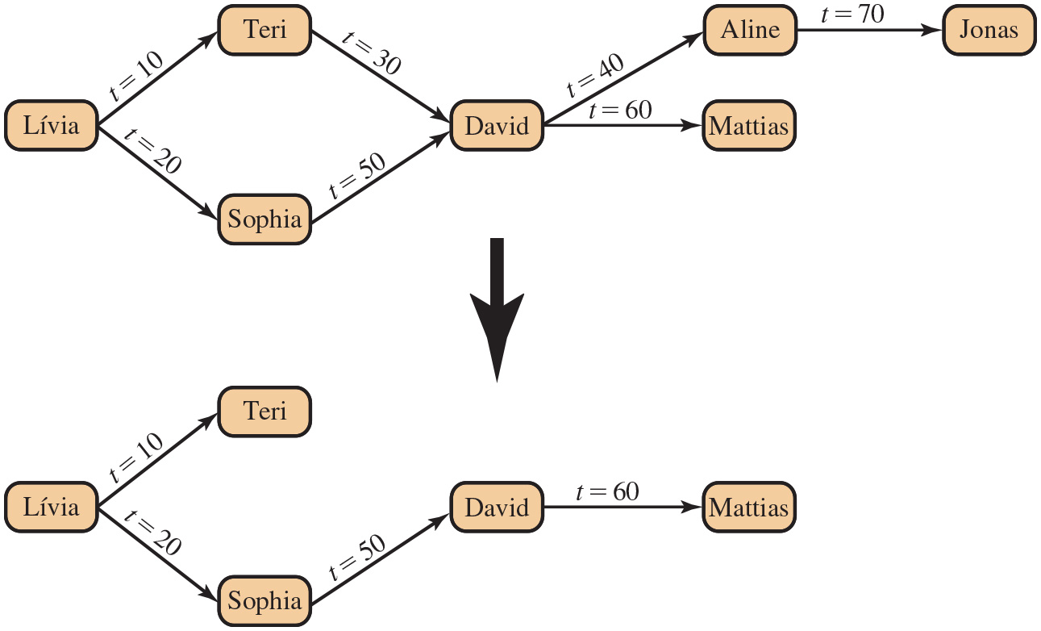
Figure 5.6
Bob Revokes Privilege From David
Notes:
The grant option enables cascading authorizations. These allow an access right to cascade through a number of users. We consider a specific access right and illustrate the cascade phenomenon in Figure 5.6. The figure indicates that Lívia grants the access right to Teri at time t 10= and to Sophia at time t 20.= Assume the grant option is always used. Thus, Teri is able to grant the access right to David at t 30.= Sophia redundantly grants the access right to David at t 50.= Meanwhile, David grants the right to Aline, who in turn grants it to Jonas, and subsequently David grants the right to Mattias.
Just as the granting of privileges cascades from one user to another using the grant option, the revocation of privileges also cascades. Thus, if Lívia revokes the access right to Teri and Sophia, the access right is also revoked to David, Aline, Jonas, and Mattias. A complication arises when a user receives the same access right multiple times, as happens in the case of David. Suppose Teri revokes the privilege from David. David still has the access right because it was granted by Sophia at t 50.=
However, David granted the access right to Aline after receiving the right, with grant option, from Teri but prior to receiving it from Sophia. Most implementations dictate that in this circumstance, the access right to Aline and therefore Jonas is revoked when Teri revokes the access right to David. This is because at t 40,= when David granted the access right to Aline, David only had the grant option to do this from Teri. When Teri revokes the right, this causes all subsequent cascaded grants that are traceable solely to Teri via David to be revoked. Because David granted the access right to Mattias after David was granted the access right with grant option from Sophia, the access right to Mattias remains. These effects are shown in the lower portion of Figure 5.6.
To generalize, the convention followed by most implementations is as follows. When user A revokes an access right, any cascaded access right is also revoked, unless that access right would exist even if the original grant from A had never occurred. This convention was first proposed in [GRIF76].
Long Description:
In the diagrams, each branch has an accompanying t value. First diagram: Initially, two branches extend from Livia to Teri and Sophia with the accompanying values t equals 10 and t equals 20 respectively. A branch is further extended from both Teri and Sophia to David with the accompanying values t equals 30 and t equals 50 respectively. Two branches then extend from David to Aline and Mattias with the accompanying values t equals 40 and t equals 60 respectively. Finally, a branch extends from Aline to Jonas with the accompanying value of t equals 70. Second diagram: This diagram recreates the first diagram by removing the branches from Teri to David, David to Aline, and Aline to Jonas.

Slide 26
Role-Based Access Control (R B A C) (1 of 2)
Role-based access control eases administrative burden and improves security
A database R B A C needs to provide the following capabilities:
Create and delete roles
Define permissions for a role
Assign and cancel assignment of users to roles
Notes:
A role-based access control (R B A C) scheme is a natural fit for database access control. Unlike a file system associated with a single or a few applications, a database system often supports dozens of applications. In such an environment, an individual user may use a variety of applications to perform a variety of tasks, each of which requires its own set of privileges. It would be poor administrative
practice to simply grant users all of the access rights they require for all the tasks they perform. R B A C provides a means of easing the administrative burden and improving security.
In a discretionary access control environment, we can classify database users into three broad categories:
• Application owner: An end user who owns database objects (tables, columns, rows) as part of an application. That is, the database objects are generated by the application or are prepared for use by the application.
End user other than application owner: An end user who operates on database objects via a particular application but does not own any of the database objects.
• Administrator: User who has administrative responsibility for part or all of the database.
We can make some general statements about R B A C concerning these three types of users. An application has associated with it a number of tasks, with each task requiring specific access rights to portions of the database. For each task, one or more roles can be defined that specify the needed access rights. The application owner may assign roles to end users. Administrators are responsible for more sensitive or general roles, including those having to do with managing physical and logical database components, such as data files, users, and security mechanisms. The system needs to be set up to give certain
administrators certain privileges. Administrators in turn can assign users to administrative-related roles.
A database R B A C facility needs to provide the following capabilities:
• Create and delete roles.
• Define permissions for a role.
• Assign and cancel assignment of users to roles.

Slide 27
Role-Based Access Control (R B A C) (2 of 2)
Categories of database users:
Application owner
An end user who owns database objects as part of an application
End user
An end user who operates on database objects via a particular application but does not own any of the database objects
Administrator
User who has administrative responsibility for part or all of the database

Slide 28
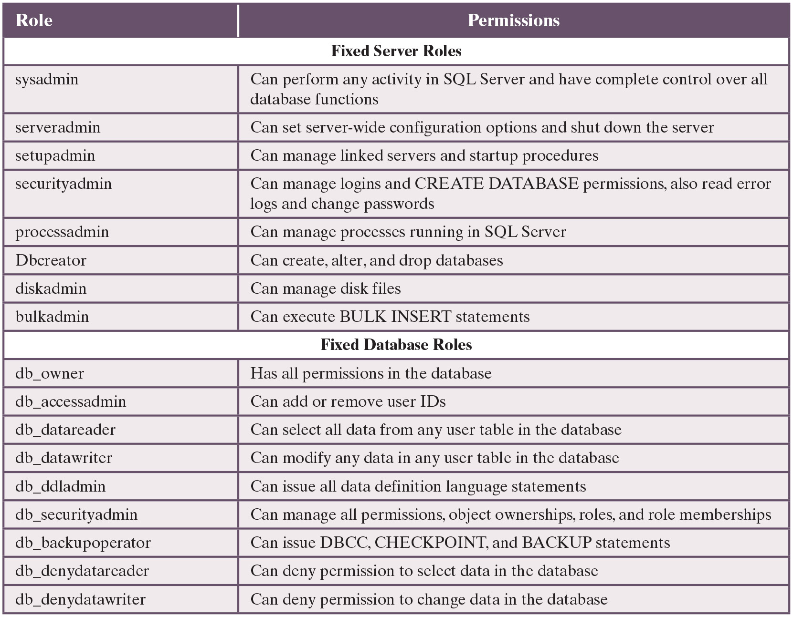
Table 5.2
Fixed Roles in Microsoft S Q L Server
Notes:
A good example of the use of roles in database security is the RBAC facility provided by Microsoft SQL Server. SQL Server supports three types of roles: server roles, database roles, and user-defined roles. The first two types of roles are referred to as fixed roles (see Table 5.2); these are preconfigured for a system with specific access rights. The administrator or user cannot add, delete, or modify fixed roles; it is only possible to add and remove users as members of a fixed role.
Fixed server roles are defined at the server level and exist independently of any user database. They are designed to ease the administrative task. These roles have different permissions and are intended to provide the ability to spread the administrative responsibilities without having to give out complete control. Database administrators can use these fixed server roles to assign different administrative tasks to personnel and give them only the rights they absolutely need.
Fixed database roles operate at the level of an individual database. As with fixed server roles, some of the fixed database roles, such as db_accessadmin and db_securityadmin, are designed to assist a DBA with delegating administrative responsibilities. Others, such as db_datareader and db_datawriter, are designed to provide blanket permissions for an end user.
SQL Server allows users to create roles. These user-defined roles can then be assigned access rights to portions of the database. A user with proper authorization (typically, a user assigned to the db_securityadmin role) may define a new role and associate access rights with the role. There are two types of user-defined roles: standard and application. For a standard role, an authorized user can assign other users to the role. An application role is associated with an application rather than with a group of users and requires a password. The role is activated when an application executes the appropriate code. A user who has access to the application can use the application role for database access. Often database applications enforce their own security based on the application logic. For example, you can use an application role with its own password to allow the particular user to obtain and modify any data only during specific hours. Thus, you can realize more complex security management within the application logic.
Long Description:
The table consists of 2 columns and 19 rows. The headings of the columns are as follows. Column 1: Role and Column 2: Permissions. The row entries are as follows. For Fixed Server Roles. Row 1: Column 1: sysadmin. Column 2: Can perform any activity in S Q L Server and have complete control over all database functions. Row 2: Column 1: serveradmin. Column 2: Can set server-wide configuration options and shut down the server. Row 3: Column 1: setupadmin. Column 2: Can manage linked servers and startup procedures. Row 4: Column 1: securityadmin. Column 2: Can manage logins and CREATE DATABASE permissions, also read error logs and change passwords. Row 5: Column 1: processadmin. Column 2: Can manage processes running in S Q L Server. Row 6: Column 1: Dbcreator. Column 2: Can create, alter, and drop databases. Row 7: Column 1: diskadmin. Column 2: Can manage disk files. Row 8: Column 1: bulkadmin. Column 2: Can execute BULK INSERT statements. For Fixed Database Roles. Row 1: Column 1: db underscore owner. Column 2: Has all permissions in the database. Row 2: Column 1: db underscore accessadmin. Column 2: Can add or remove user I Ds. Row 3: Column 1: db underscore datareader. Column 2: Can select all data from any user table in the database. Row 4: Column 1: db underscore datawriter. Column 2: Can modify any data in any user table in the database. Row 5: Column 1: db underscore ddladmin. Column 2: Can issue all data definition language statements. Row 6: Column 1: db underscore securityadmin. Column 2: Can manage all permissions, object ownerships, roles, and role memberships. Row 7: Column 1: db underscore backupoperator. Column 2: Can issue D B C C, CHECKPOINT, and BACKUP statements. Row 8: Column 1: db underscore denydatareader. Column 2: Can deny permission to select data in the database. Row 9: Column 1: db underscore denydatawriter. Column 2: Can deny permission to change data in the database.

Slide 29
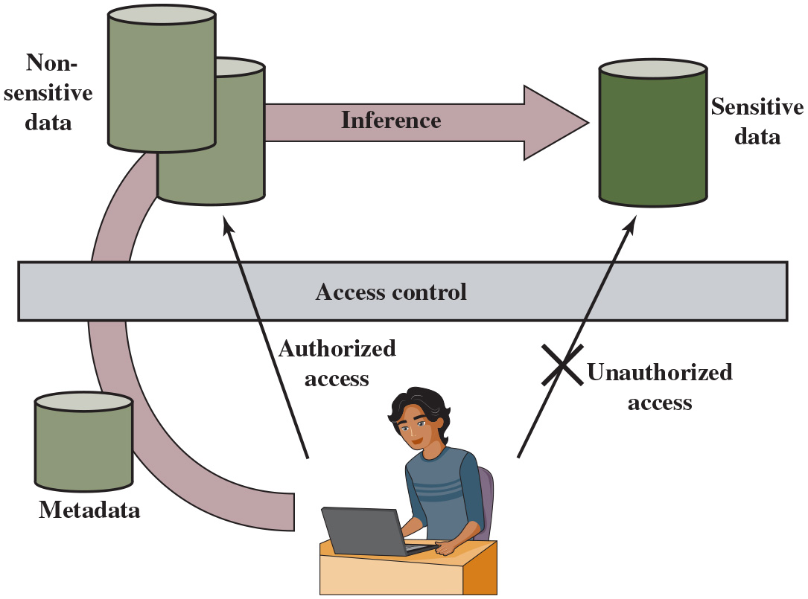
Figure 5.7
Indirect Information Access Via Inference Channel
Notes:
Inference, as it relates to database security, is the process of performing authorized queries and deducing unauthorized information from the legitimate responses received. The inference problem arises when the combination of a number of data items is more sensitive than the individual items, or when a combination of data items can be used to infer data of a higher sensitivity. Figure 5.7 illustrates the process. The attacker may make use of nonsensitive data as well as metadata. Metadata refers to knowledge about correlations or dependencies among data items that can be used to deduce information not otherwise available to a particular user. The information transfer path by which unauthorized data are obtained is referred to as an inference channel.
Long Description:
The diagram consists of a user, metadata, non-sensitive data, and sensitive data as the primary components. The user has to take access to data which he can take with a well-defined authorized access path that can be explained as follows. At first, the metadata accompanies a user request to access control. Based on this metadata, access control allows the user to get access to non-sensitive data with inference to sensitive data. Note that the user cannot get access control directly to sensitive data that depicts unauthorized access.

Slide 30
Figure 5.8 (1 of 2)
Inference Example
(a) Inventory table
Item | Availability | Cost ($) | Department
Shelf support | in-store/online | 7.99 | hardware
Lid support | online only | 5.49 | hardware
Decorative chain | in-store/online | 104.99 | hardware
Cake pan | online only | 12.99 | housewares
Shower/tub cleaner | in-store/online | 11.99 | housewares
Rolling pin | in-store/online | 10.99 | housewares
(b) Two views
Availability | Cost ($)
in-store/online | 7.99
online only | 5.49
in-store/online | 104.99
Item | Department
Shelf support | hardware
Lid support | hardware
Decorative chain | hardware
Notes:
In general terms, two inference techniques can be used to derive additional information: analyzing functional dependencies between attributes within a table or across tables and merging views with the same constraints.
An example of the latter, shown in Figure 5.8, illustrates the inference problem.
Users of these views are not authorized to access the relationship between Item and Cost. A user who has access to either or both views cannot infer the relationship by functional dependencies. That is, there is not a functional relationship between Item and Cost such that knowing Item and perhaps other information is sufficient to deduce Cost. However, suppose the two views are created with the access constraint that Item and Cost cannot be accessed together. A user who knows the structure of the Inventory table and who knows that the view tables maintain the same row order as the Inventory table is then able to merge the two views to construct the table shown in Figure 5.8c. This violates the access control policy that the relationship of attributes Item and Cost must not be disclosed.

Slide 31
Figure 5.8 (2 of 2)
Inference Example
(c) Table derived from combining query answers
Item | Availability | Cost ($) | Department
Shelf support | in-store/online | 7.99 | hardware
Lid support | online only | 5.49 | hardware
Decorative chain | in-store/online | 104.99 | hardware

Slide 32
Inference Detection
Two approaches
Inference detection during database design
Approach removes an inference channel by altering the database structure or by changing the access control regime to prevent inference
Techniques in this category often result in unnecessarily stricter access controls that reduce availability
Inference detection at query time
Approach seeks to eliminate an inference channel violation during a query or series of queries
If an inference channel is detected, the query is denied or altered
Some inference detection algorithm is needed for either of these approaches
Progress has been made in devising specific inference detection techniques for some specialized types of databases
Notes:
In general terms, there are two approaches to dealing with the threat of disclosure by inference:
• Inference detection during database design: This approach removes an inference channel by altering the database structure or by changing the access control regime to prevent inference. Examples include removing data dependencies by splitting a table into multiple tables or using more fine-grained access control roles in an RBAC scheme. Techniques in this category often result in unnecessarily stricter access controls that reduce availability.
• Inference detection at query time: This approach seeks to eliminate an inference channel violation during a query or series of queries. If an inference channel is detected, the query is denied or altered.
For either of the preceding approaches, some inference detection algorithm is needed. This is a difficult problem and is the subject of ongoing research. To give some appreciation of the difficulty, we present an example taken from [LUNT89]. Consider a database containing personnel information, including names, addresses, and salaries of employees. Individually, the name, address, and salary information is available to a subordinate role, such as Clerk, but the association of names and salaries is restricted to a superior role, such as Administrator. This is similar to the problem illustrated in Figure 5.8. One solution to this problem is to construct three tables, which include the following information:
Employees (Emp#, Name, Address)
Salaries (S#, Salary)
Emp-Salary (Emp#, S#)
where each line consists of the table name followed by a list of column names for that table. In this case, each employee is assigned a unique employee number (Emp#) and a unique salary number (S#). The Employees table and the Salaries table are accessible to the Clerk role, but the Emp-Salary table is only available to the Administrator role. In this structure, the sensitive relationship between employees
and salaries is protected from users assigned the Clerk role. Now suppose that we want to add a new attribute, employee start date, which is not sensitive. This could be added to the Salaries table as follows:
Employees (Emp#, Name, Address)
Salaries (S#, Salary, Start-Date)
Emp-Salary (Emp#, S#)
However, an employee’s start date is an easily observable or discoverable attribute. Thus a user in the Clerk role should be able to infer (or partially infer) the employee’s name. This would compromise the relationship between employee and salary. A straightforward way to remove the inference channel is to add the start-date column to the Employees table rather than to the Salaries table.
The first security problem indicated in this sample, that it was possible to infer the relationship between employee and salary, can be detected through analysis of the data structures and security constraints that are available to the DBMS. However, the second security problem, in which the start-date column was added to the Salaries table, cannot be detected using only the information stored in the
database. In particular, the database does not indicate that the employee name can be inferred from the start date.
In the general case of a relational database, inference detection is a complex and difficult problem. For some specialized types of databases, progress has been made in devising specific inference detection techniques.

Slide 33
Database Encryption (1 of 2)
The database is typically the most valuable information resource for any organization
Protected by multiple layers of security
Firewalls, authentication, general access control systems, D B access control systems, database encryption
Encryption becomes the last line of defense in database security
Can be applied to the entire database, at the record level, the attribute level, or level of the individual field
Notes:
The database is typically the most valuable information resource for any organization and is therefore protected by multiple layers of security, including firewalls, authentication mechanisms, general access control systems, and database access control systems. In addition, for particularly sensitive data, database encryption is warranted and often implemented. Encryption becomes the last line of defense in database security.
There are two disadvantages to database encryption:
• Key management: Authorized users must have access to the decryption key for the data for which they have access. Because a database is typically accessible to a wide range of users and a number of applications, providing secure keys to selected parts of the database to authorized users and applications is a complex task.
• Inflexibility: When part or all of the database is encrypted, it becomes more difficult to perform record searching.
Encryption can be applied to the entire database, at the record level (encrypt selected records), at the attribute level (encrypt selected columns), or at the level of the individual field.
A number of approaches have been taken to database encryption. In this section, we look at a representative approach for a multiuser database.
A D B M S is a complex collection of hardware and software. It requires a large storage capacity and requires skilled personnel to perform maintenance, disaster protection, updates, and security. For many small and medium-sized organizations, an attractive solution is to outsource the D B M S and the database to a service provider. The service provider maintains the database off site and can provide high availability, disaster prevention, and efficient access and updates. The main concern with such a solution is the confidentiality of the data.

Slide 34
Database Encryption (2 of 2)
Disadvantages to encryption:
Key management
Authorized users must have access to the decryption key for the data for which they have access
Inflexibility
When part or all of the database is encrypted it becomes more difficult to perform record searching

Slide 35
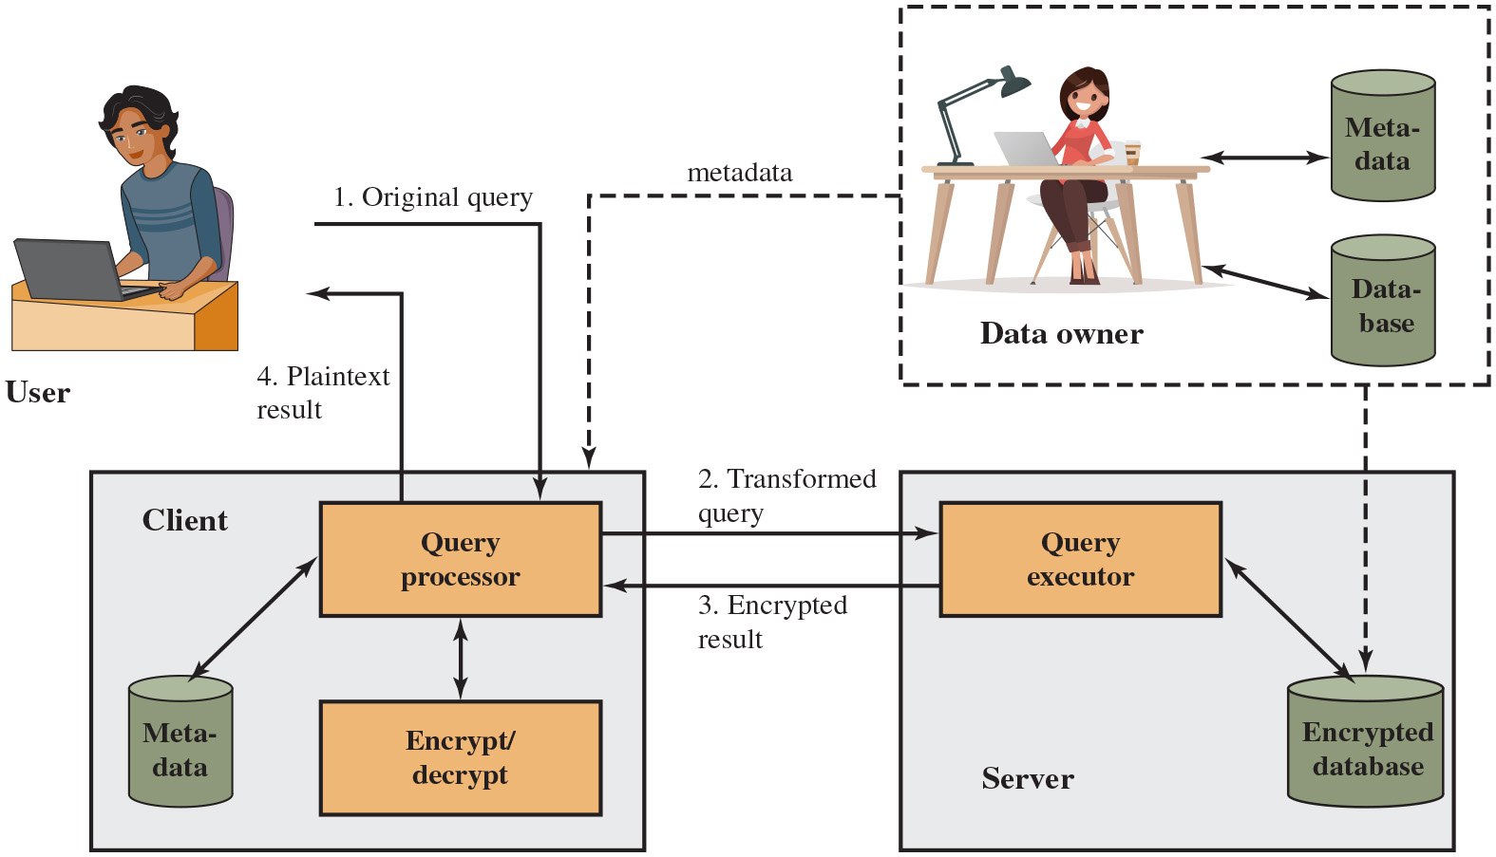
Figure 5.9
A Database Encryption Scheme
Notes:
A straightforward solution to the security problem in this context is to encrypt the entire database and not provide the encryption/decryption keys to the service provider. This solution by itself is inflexible. The user has little ability to access individual data items based on searches or indexing on key parameters, but rather would have to download entire tables from the database, decrypt the tables, and work with the results. To provide more flexibility, it must be possible to work with the database in its encrypted form.
An example of such an approach, depicted in Figure 5.9, is reported in [DAMI05] and [DAMI03]. A similar approach is described in [HACI02]. Four entities are involved:
• Data owner: An organization that produces data to be made available for controlled release, either within the organization or to external users.
• User: Human entity that presents requests (queries) to the system. The user could be an employee of the organization who is granted access to the database via the server or a user external to the organization who, after authentication, is granted access.
Client: Frontend that transforms user queries into queries on the encrypted data stored on the server.
• Server: An organization that receives the encrypted data from a data owner and makes them available for distribution to clients. The server could in fact be owned by the data owner, but it is more typically a facility owned and maintained by an external provider.
Let us first examine the simplest possible arrangement based on this scenario. Suppose each individual item in the database is encrypted separately using the same encryption key. The encrypted database is stored at the server, but the server does not have the key, so the data are secure at the server. Even if someone were able to hack into the server’s system, all they would have access to is encrypted data. The client system does have a copy of the encryption key. A user at the client can retrieve a record from the database with the following sequence:
1. The user issues an SQL query for fields from one or more records with a specific value of the primary key.
2. The query processor at the client encrypts the primary key, modifies the SQL query accordingly, and transmits the query to the server.
3. The server processes the query using the encrypted value of the primary key and returns the appropriate record or records.
4. The query processor decrypts the data and returns the results.
A user at the client can retrieve a record from the database with the following sequence. Step 1. The user issues an original query to the query processor at the client. Step 2. The query processor at the client encrypts and decrypts the primary key, modifies the query, and transmits the query to the query executor at the server. The query processor uses met data and met data uses query processor. Step 3. The server processes the query using the encrypted database of the primary key and returns the appropriate records. Step 4. The query processor decrypts the data and returns the results as a plain text. Step 5. The data owner sends the met data to the client and data base to the encrypted data bases at the server.
Long Description:
The diagram consists of two primary systems namely a client's system and a server. The client's system consists of the query processor, encrypt or decrypt system, and metadata where the query processor interacts with the latter two. The server consists of a query executor and an encrypted database where both are interacted with each other. The scheme can be explained in the following four steps. Step 1: The user sends the original query to the client’s query processor. Step 2: The query processor sends the transformed query to the server’s query executor. Step 3: The server returns the encrypted result to the query processor. Step 4: The query processor sends the plain text result to the user. Note that the data owner interacts with the metadata as well as the database. The client and the encrypted server database both receive metadata from the data owner.

Slide 36
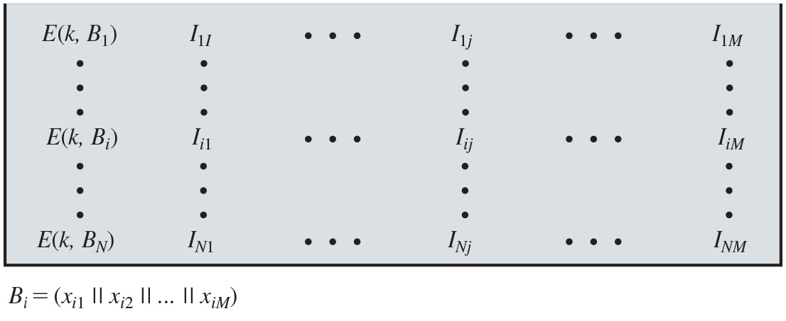
Figure 5.10
Encryption Scheme for Database of Figure 5.3
Notes:
Each record (row) of a table in the database is encrypted as a block. Referring to the abstract model of a relational database in Figure 5.3, each row Ri is treated as a contiguous block Bi = (xi1 || xi2 ||…|| xiM). Thus, each attribute value in Ri, regardless of whether it is text or numeric, is treated as a sequence of bits, and all of the attribute values for that row are concatenated together to form a single binary block. The entire row is encrypted, expressed as E (k, Bi) = E (k, (xi1 || xi2 ||…|| xiM)). To assist in data retrieval, attribute indexes are associated with each table. For some or all of the attributes an index value is created. For each row Ri of the unencrypted database, the mapping is as follows (see Figure 5.10):
(x_{i1}, x_{i2}, …, x_{iM}) →[E (k, B_{i}), I_{i1}, Ii2, …, I_{iM} ]
For each row in the original database, there is one row in the encrypted database. The index values are provided to assist in data retrieval. We can proceed as follows. For any attribute, the range of attribute values is divided into a set of non-overlapping partitions that encompass all possible values, and an index value is assigned to each partition.
Long Description:
The table consists of N number of rows and M plus 1 number of columns. The elements along each column array can be listed as follows. Column 1: The elements are given by the variable E of k, B subscript i where i varies from 1 to N. Column 2: The elements are given by the variable I subscript i 1 where i varies from 1 to N. Column 3: The elements are given by the variable I subscript i j where i varies from 1 to N and j is any fixed integral number. Column M plus 1: The elements are given by the variable I subscript i M where i varies from 1 to N. Note each B subscript i BaseLine equals OpenParenthesis x subscript i 1 BaseLine double pipe x subscript i 2 BaseLine double pipe, and so on, to double pipe x subscript i M BaseLine CloseParenthesis.

Slide 37
Table 5.3
Encrypted Database Example
(a) Employee Table
eid | ename | salary | addr | did
23 | Tom | 70K | Maple | 45
860 | Mary | 60K | Main | 83
320 | John | 50K | River | 50
875 | Jerry | 55K | Hopewell | 92
(b) Encrypted Employee Table with Indexes
E(k, B) | I(eid) | I(ename) | I(salary) | I(addr) | I(did)
1100110011001011... | 1 | 10 | 3 | 7 | 4
0111000111001010... | 5 | 7 | 2 | 7 | 8
1100010010001101... | 2 | 5 | 1 | 9 | 5
0011010011111101... | 5 | 5 | 2 | 4 | 9
Notes:
Table 5.3 provides an example of this mapping. Suppose the employee ID (eid) values lie in the range [1, 1000]. We can divide these values into five partitions, [1, 200], [201, 400], [401, 600], [601, 800], and [801, 1000], and then assign index values 1, 2, 3, 4, and 5, respectively. For a text field, we can derive an index from the first letter of the attribute value. For the attribute ename, let us assign index 1 to values starting with A or B, index 2 to values starting with C or D, and so on. Similar partitioning schemes can be used for each of the attributes. Table 5.3b shows the resulting table. The values in the first column represent the encrypted values for each row. The actual values depend on the encryption algorithm and the encryption key. The remaining columns show index values for the corresponding attribute values. The mapping functions between attribute values and index values constitute metadata that are stored at the client and data owner locations but not at the server. This arrangement provides for more efficient data retrieval. Suppose, for example, a user requests records for all employees with eid 6 < 300. The query processor requests all records with I (eid) = 2. These are returned by the server. The query processor decrypts all rows returned, discards those that do not match the original query, and returns the requested unencrypted data to the user.
The indexing scheme just described does provide a certain amount of information to an attacker, namely a rough relative ordering of rows by a given attribute. To obscure such information, the ordering of indexes can be randomized. For example, the eid values could be partitioned by mapping [1, 200], [201, 400], [401, 600], [601, 800], and [801, 1000] into 2, 3, 5, 1, and 4, respectively. Because the metadata are
not stored at the server, an attacker could not gain this information from the server.
Other features may be added to this scheme. To increase the efficiency of accessing records by means of the primary key, the system could use the encrypted value of the primary key attribute values or a hash value. In either case, the row corresponding to the primary key value could be retrieved individually. Different portions of the database could be encrypted with different keys, so users would only have access to that portion of the database for which they had the decryption key. This latter scheme could be incorporated into a role-based access control system.

Slide 38
Data Center Security
Data center:
An enterprise facility that houses a large number of servers, storage devices, and network switches and equipment
The number of servers and storage devices can run into the tens of thousands in one facility
Generally includes redundant or backup power supplies, redundant network connections, environmental controls, and various security devices
Can occupy one room of a building, one or more floors, or an entire building
Examples of uses include:
Cloud service providers
Search engines
Large scientific research facilities
I T facilities for large enterprises
Notes:
A data center is an enterprise facility that houses a large number of servers, storage devices, and network switches and equipment. The number of servers and storage devices can run into the tens of thousands in a single facility. Examples of uses for these large data centers include cloud service providers, search engines, large scientific research facilities, and I T facilities for large enterprises. A data center generally includes redundant or backup power supplies, redundant network connections, environmental controls (e.g., air conditioning and fire suppression), and various security devices. Large data centers are industrial-scale operations using as much electricity as a small town. A data center can occupy one room of a building, one or more floors, or an entire building.

Slide 39
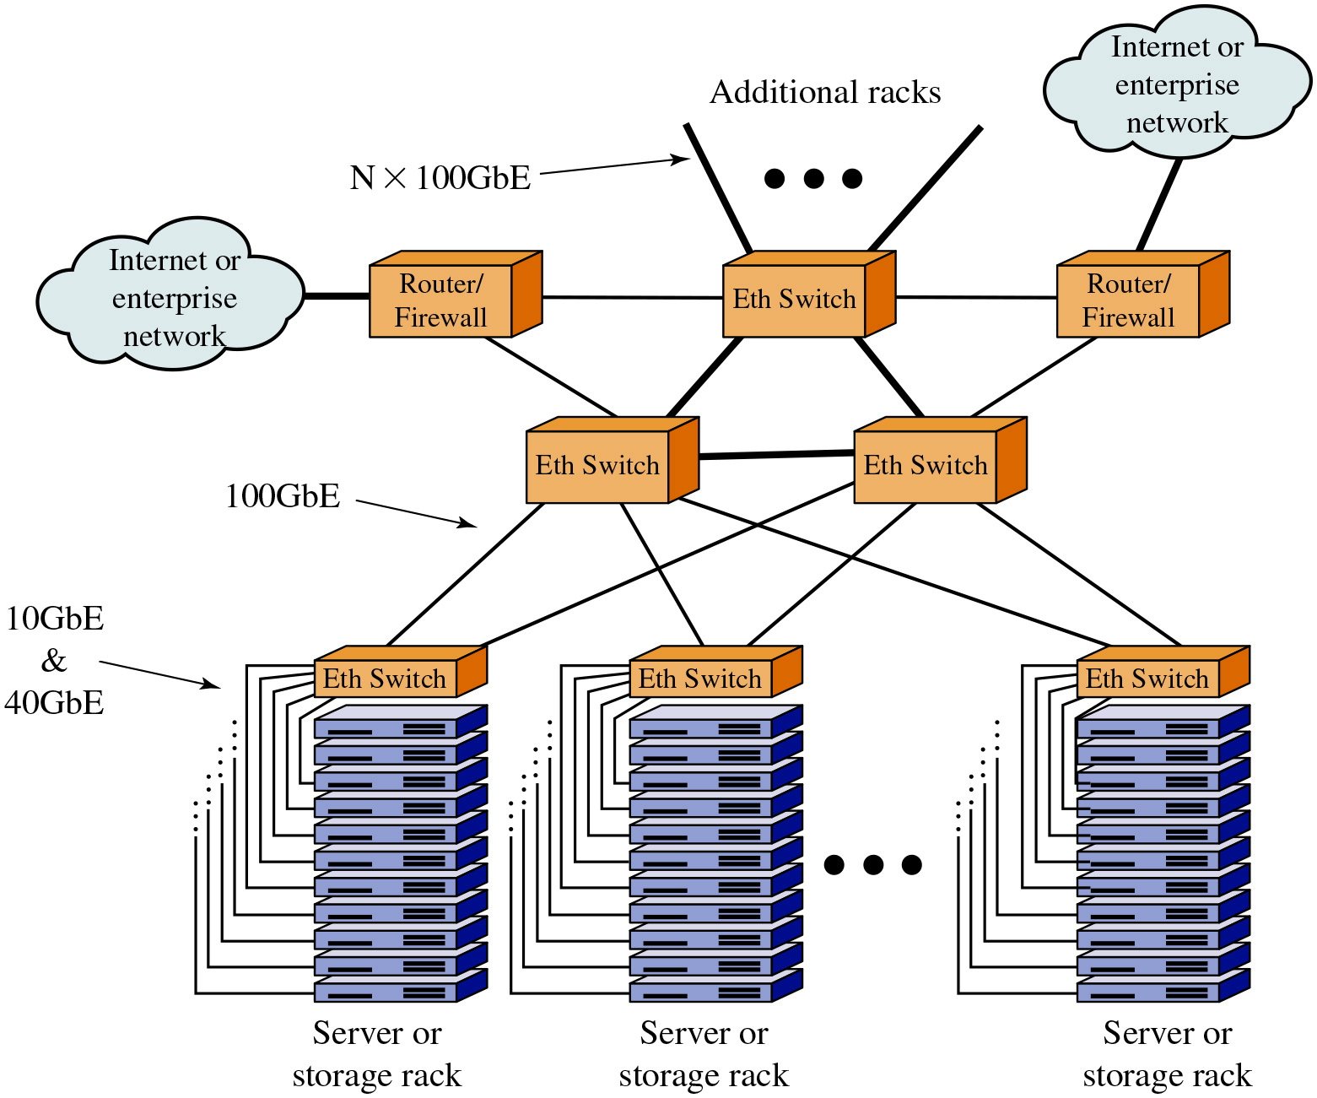
Figure 5.11
Key Data Center Elements
Notes:
Figure 5.11 illustrates key elements of a large data center configuration. Most of the equipment in a large data center is in the form of stacks of servers and storage modules mounted in open racks or closed cabinets, which are usually placed in single rows that form corridors between them. This allows access to the front and rear of each rack or cabinet. Typically, the individual modules are equipped with 10-Gbps or 40-Gbps Ethernet ports to handle the massive traffic to and from the servers. Also typically, each rack has one or two 10-, 40-, or 100-Gbps Ethernet switches to interconnect all the servers and provide connectivity to the rest of the facility. The switches are often mounted in the rack and referred to as top-of-rack (ToR) switches. The term ToR has become synonymous with server access switch, even if it is not located “top of rack.” Very large data centers, such as cloud providers, require switches operating at 100 Gbps to support the interconnection of server racks and to provide adequate capacity for connecting off-site through network interface controllers (NICs) on routers or firewalls.
Key elements not shown in Figure 5.11 are cabling and cross connects, which we can list as follows:
• Cross connect: A facility enabling the termination of cables, as well as their interconnection with other cabling or equipment.
• Horizontal cabling: Any cabling that is used to connect a floor’s wiring closet to wall plates in the work areas to provide local area network (LAN) drops for connecting servers and other digital equipment to the network. The term horizontal is used because such cabling is typically run along the ceiling or floor.
• Backbone cabling: Run between data center rooms or enclosures and the main cross-connect point of a building.
The large data center is in the form of stacks of servers mounted in open racks placed in single rows with corridors between them. The each rack has one 10 G b E and 40 G b E ethernet switches to interconnect the servers and provides connectivity to the rest of the facility. The switches operates at 100 G b E to interconnect the server racks and to connect off site through network interface controllers on routers and firewalls.
Long Description:
The key data center elements consist of the following primary components: a series of server or storage racks, a network of Ethernet switches, and a router or firewall. The connections between the above-mentioned components can be explained in the diagram as follows. A series of 10 G b E and 40 G b E servers and storage racks are connected to a network of Ethernet switches. The switches control access to routers or firewalls which are further connected to the internet or enterprise network. Also, the switches control access to N by 100 G b E additional racks.

Slide 40
Figure 5.12
Data Center Security Model
Data Security | Encryption, Password policy, Secure I Ds, Data Protection (I S O 27002), Data masking, Data retention, etc.
Network Security | Firewalls, Anti-virus, Intrusion detection/prevention, Authentication, etc.
Physical Security | Surveillance, Mantraps, Two/three factor authentication, Security zones, I S O 27001/27002, etc.
Site Security | Setbacks, Redundant utilities Landscaping, Buffer zones, Crash barriers, Entry points, etc.
Notes:
All of the security threats and countermeasures discussed in this text are relevant in the context of large data centers, and indeed it is in this context that the risks are most acute. Consider that the data center houses massive amounts of data that are:
• Located in a confined physical space.
• Interconnected with direct-connect cabling.
• Accessible through external network connections, so once past the boundary, a threat is posed to the entire complex.
• Typically representative of the greatest single asset of the enterprise.
Thus, data center security is a top priority for any enterprise with a large data center. Some of the important threats to consider include the following:
• Denial of service
• Advanced persistent threats from targeted attacks
• Privacy breaches
• Application exploits such as S Q L injection
• Malware
• Physical security threats
Figure 5.12 highlights important aspects of data center security, represented as a four-layer model. Site security refers primarily to the physical security of the entire site, including the building that houses the data center as well as the use of redundant utilities. Physical security of the data center itself includes barriers to entry, such as a mantrap (a double-door single-person access control space) coupled with authentication techniques for gaining physical access. Physical security can also include security personnel, surveillance systems, and other measures that will be discussed in Chapter 16. Network security is extremely important in a facility in which such a large collection of assets are concentrated in a single place and accessible by external network connections. Typically, a large data center will employ all of the network security techniques discussed in this text. Finally, security of the data themselves, as opposed to the systems they reside on, involves techniques discussed in the remainder of this chapter.

Slide 41
T I A-492 (1 of 2)
The Telecommunications Industry Association (T I A)
T I A-492 (Telecommunications Infrastructure Standard for Data Centers) specifies the minimum requirements for telecommunications infrastructure of data centers
Notes:
The Telecommunications Industry Association (T I A) standard T I A-492 (Telecommunications Infrastructure Standard for Data Centers) specifies the minimum requirements for telecommunications infrastructure of data centers. Topics covered include the following:
• Network architecture
• Electrical design
• File storage, backup, and archiving
• System redundancy
• Network access control and security
• Database management
• Web hosting
• Application hosting
• Content distribution
• Environmental control
• Protection against physical hazards (fire, flood, and windstorm)
• Power management
The standard specifies function areas, which helps to define equipment placement based on the standard hierarchical design for regular commercial spaces. This architecture anticipates growth and helps create an environment where applications and servers can be added and upgraded with minimal downtime. This standardized approach supports high availability and a uniform environment for implementing security measures.

Slide 42
T I A-492 (2 of 2)
Includes topics such as:
Network architecture
Electrical design
File storage, backup, and archiving
System redundancy
Network access control and security
Database management
Web hosting
Application hosting
Content distribution
Environmental control
Protection against physical hazards
Power management

Slide 43
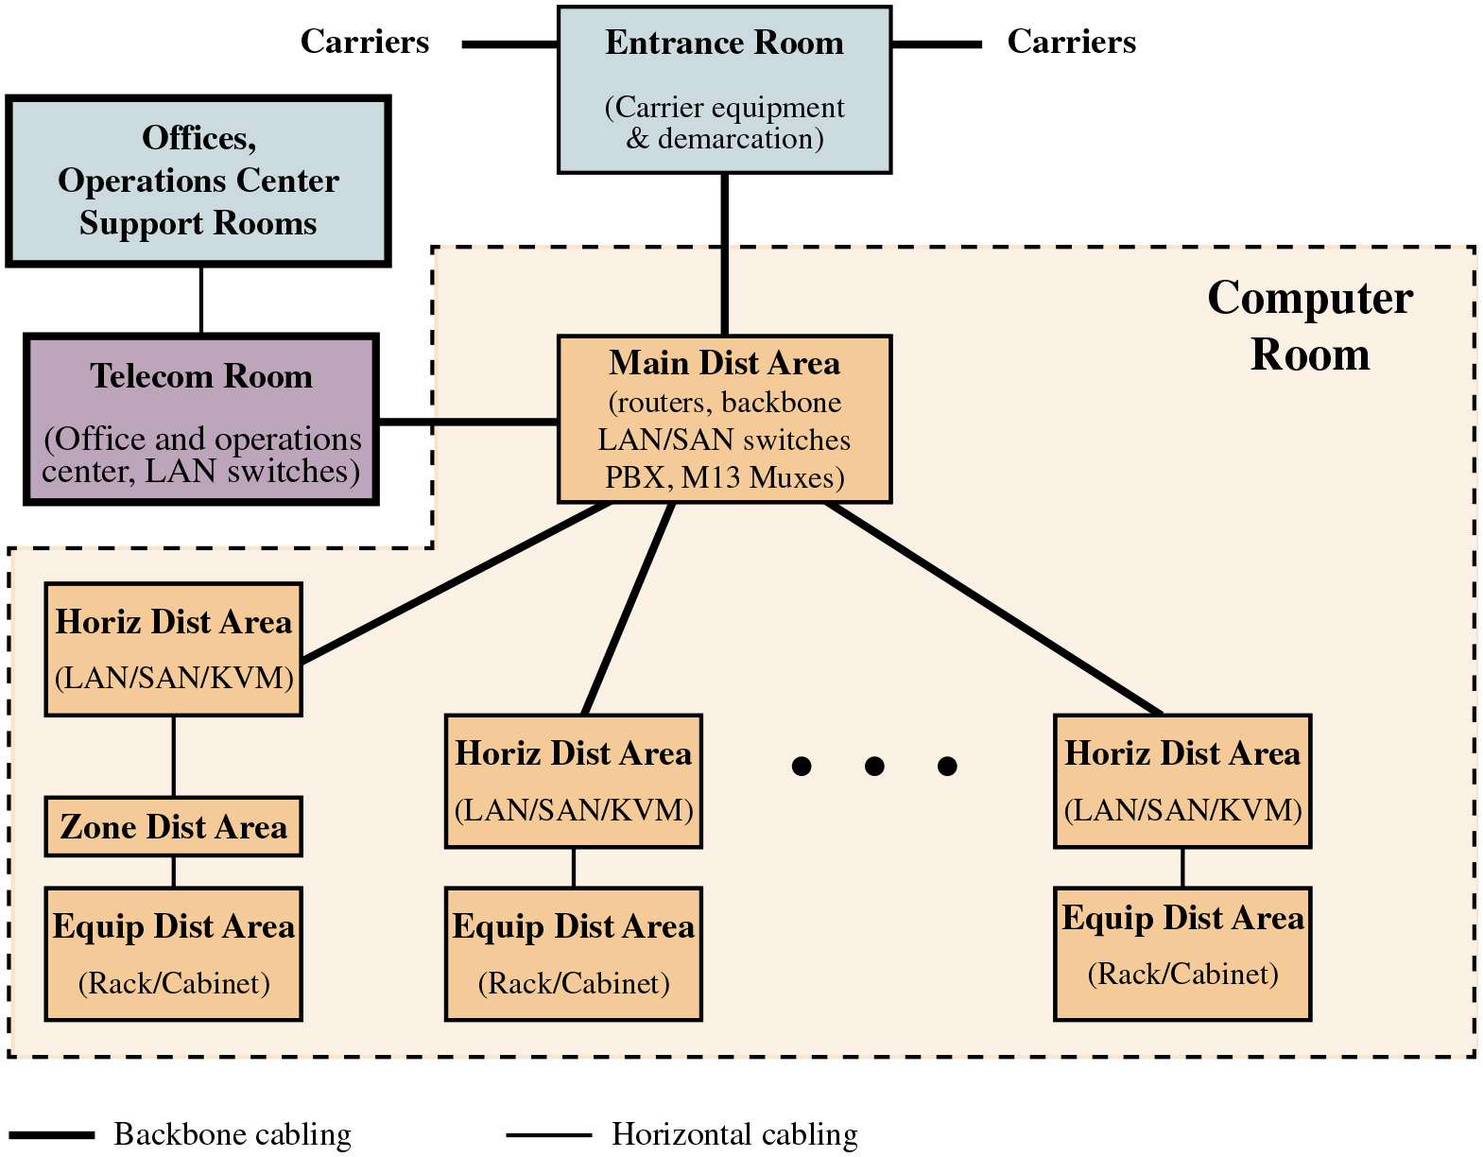
Figure 5.13
T I A-942 Compliant Data Center Showing Key Functional Areas
Notes:
TIA-942 specifies that a data center should include the following functional areas (see Figure 5.13):
• Computer room: Portion of the data center that houses data-processing equipment.
• Entrance room: One or more entrance rooms house external network access provider equipment, plus provide the interface between the computer room equipment and the enterprise cabling systems. Physical separation of the entrance room from the computer room provides better security.
• Main distribution area: A centrally located area that houses the main cross-connect as well as core routers and switches for LAN and SAN (storage area network) infrastructures.
• Horizontal distribution area (HDA): Serves as the distribution point for horizontal cabling and houses cross-connects and active equipment for distributing cable to the equipment distribution area.
• Equipment distribution area (EDA): The location of equipment cabinets and racks, with horizontal cables terminating with patch panels.
• Zone distribution area (ZDA): An optional interconnection point in the horizontal cabling between the HDA and EDA. The ZDA can act as a consolidation point for reconfiguration flexibility or for housing freestanding equipment such as mainframes.
Long Description:
The diagram consists of four rooms listed as follows: Entrance room, offices, operations center support room, telecom room, and computer room. The backbone cabling and the horizontal cabling are shown by solid lines where the width of the backbone cabling line is wider than that of the horizontal cabling. The computer room consists of a main distribution area that has a backbone cabling with several horizontal distribution areas, which have further horizontal cablings with equipment distribution areas. Here, one of the horizontal distribution areas has horizontal cabling with a zone distribution area first and then holds horizontal cabling with an equipment distribution area. The entrance room receives the carriers via backbone cabling, and the room includes carrier equipment and demarcation. The entrance room is wired to the main distribution area of the computer room by a backbone cabling. The main distribution area consists of routers, backbone L A N or S A N switches, P B X, and M 13 multiplexers. The main distribution area which is wired to horizontal distribution areas via backbone cabling consist of L A N, S A N, or K V M switches. Horizontal distribution areas service equipment distribution areas with racks and cabinets. The main distribution area is also connected to the telecom room outside the main computer room via a backbone cabling. The telecom room contains the office and operations center and L A N switches, and it is connected to the offices, operations center, and support rooms via horizontal cabling.

Slide 44
Table 5.4 (1 of 2)
Data Center Tiers Defined in T I A-942
Tier | System Design | Availability/Annual Downtime
1 | Susceptible to disruptions from both planned and unplanned activity Single path for power and cooling distribution, no redundant components May or may not have raised floor, UPS, or generator Takes 3 months to implement Must be shut down completely to perform preventive maintenance | 99.671%/28.8 hours
2 | Less susceptible to disruptions from both planned and unplanned activity Single path for power and cooling distribution, includes redundant components Includes raised floor, U P S, and generator Takes 3 to 6 months to implement Maintenance of power path and other parts of the infrastructure require a processing shutdown | 99.741%/22.0 hours
Notes:
An important part of T I A-942, especially relevant for computer security, is the concept of tiered reliability. The standard defines four tiers, as shown in Table 5.4. For each of the four tiers, T I A-942 describes detailed architectural, security, electrical, mechanical, and telecommunications recommendations such that the higher the tier, the higher the availability.

Slide 45
Table 5.4 (2 of 2)
Data Center Tiers Defined in T I A-942
Tier | System Design | Availability/Annual Downtime
3 | Enables planned activity without disrupting computer hardware operation, but unplanned events will still cause disruption Multiple power and cooling distribution paths but with only one path active, includes redundant components Takes 15 to 20 months to implement Includes raised floor and sufficient capacity and distribution to carry load on one path while performing maintenance on the other | 99.982%/1.6 hours
4 | Planned activity does not disrupt critical load and data center can sustain at least one worst-case unplanned event with no critical load impact Multiple active power and cooling distribution paths, includes redundant components Takes 15 to 20 months to implement | 99.995%/0.4 hours

Slide 46
Summary
The need for database security
Database management systems
Relational databases
Elements of a relational database system
Structured Query Language
S Q L injection attacks
A typical S Q L i attack
The injection technique
S Q L i attack avenues and types
S Q L i countermeasures
Database access control
S Q L-based access definition
Cascading authorizations
Role-based access control
Inference
Database encryption
Data center security
Data center elements
Data center security considerations
T I A-492
Notes:
Chapter 5 summary.

Slide 47

Copyright
This work is protected by United States copyright laws and is provided solely for the use of instructors in teaching their courses and assessing student learning. Dissemination or sale of any part of this work (including on the World Wide Web) will destroy the integrity of the work and is not permitted. The work and materials from it should never be made available to students except by instructors using the accompanying text in their classes. All recipients of this work are expected to abide by these restrictions and to honor the intended pedagogical purposes and the needs of other instructors who rely on these materials.

